Slide 1
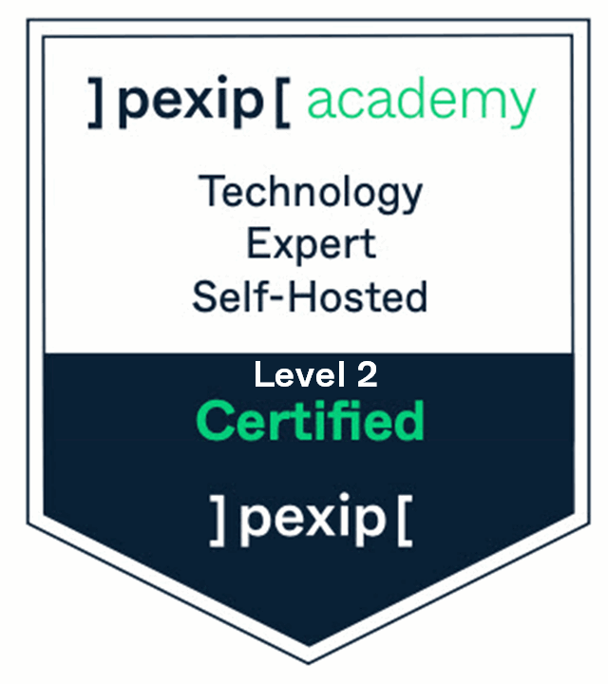

Pexip Infinity CTE
Live Virtual / In-person
Duration – 2 days
+ Optional PexClinic – half day

Slide 2
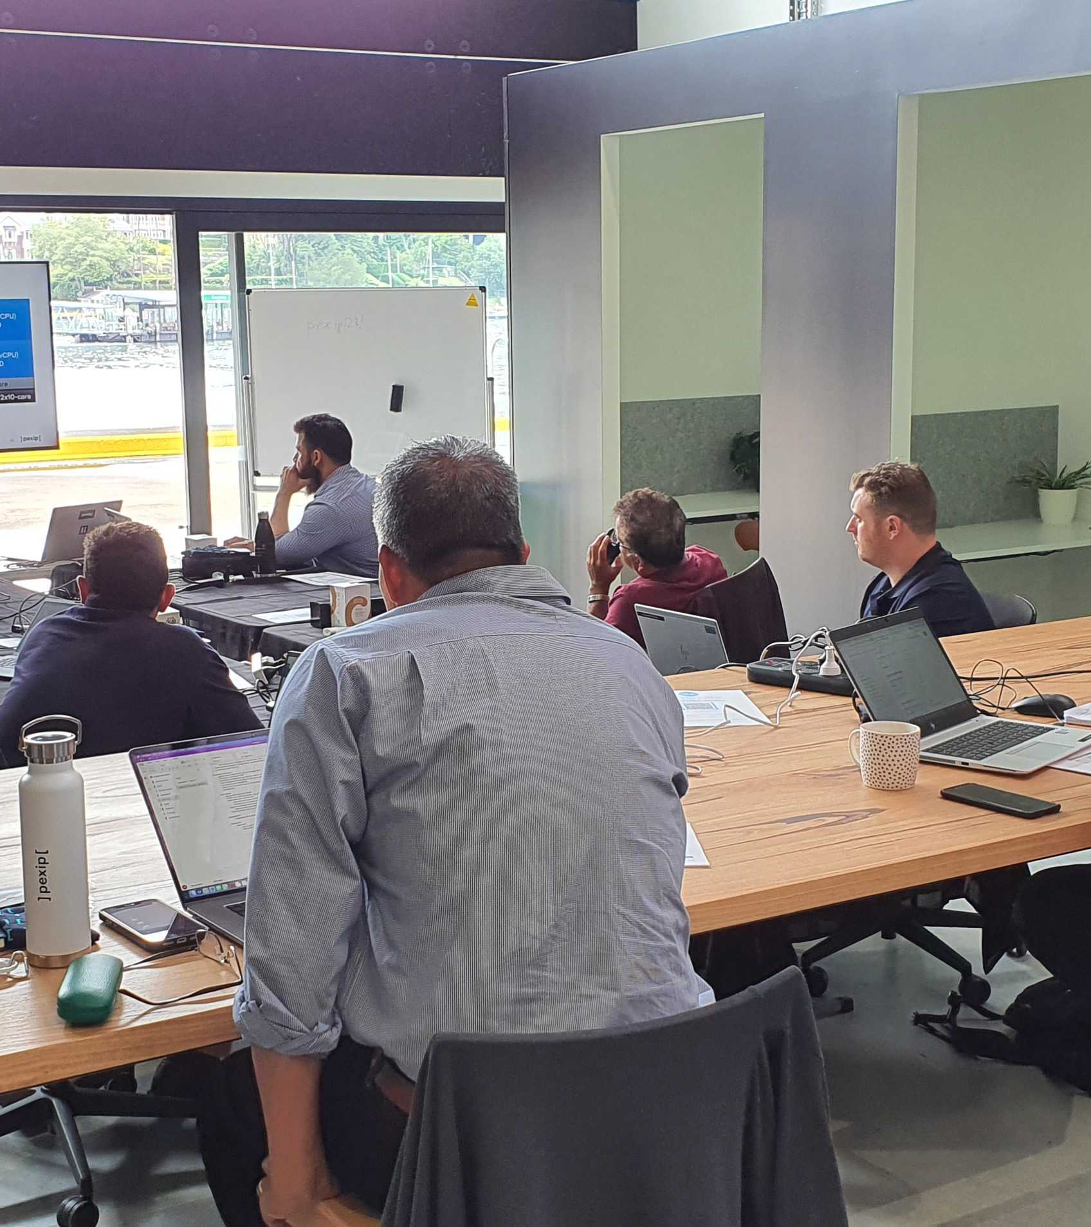
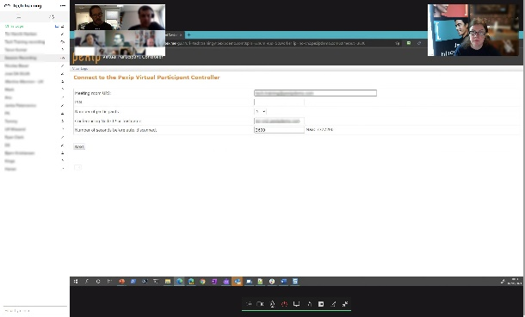
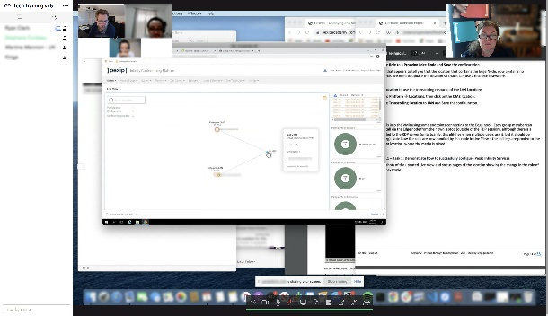

CTE Level 2 Technical Training
Course outline
The Pexip Infinity self-hosted solution
Technology basics
Implementing Pexip Infinity
Pexip integration
Placing conference calls
Course objectives
Configure Pexip Management Nodes and Pexip Conferencing Nodes
Demonstrate product use and administrator tasks
Demonstrate integration capabilities in Pexip solutions
Demonstrate the communication technologies supported by Pexip Infinity
Who should attend?
Video Support Engineers
Sales Engineers/Solution Architects
Video Systems Engineers
Video System Administrators
Channel Partners / Resellers

Slide 3
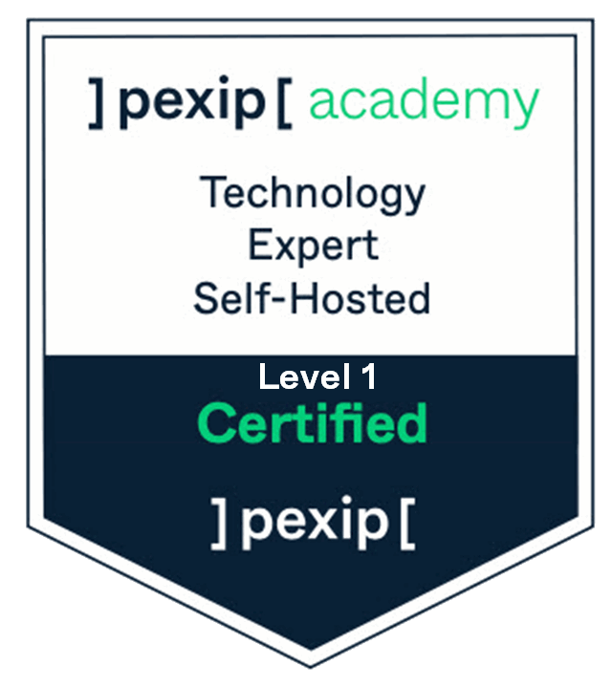


CTE Level 2 Technical Training
Prerequisites
Cisco CCNA level / Microsoft MCSE
CTE Level 1 – Fundamentals
What’s in the box?
The Certified Technology Expert Level 2 is fast-paced practical training delivered live over 2 days.
Working collaboratively you will gain hands-on experience in a virtual lab environment, deploying and configuring a Pexip Infinity platform, as well as integrating Infinity with other networked systems.
This is a technical course and we expect users to have a high level of IT experience and to be familiar with:
Video Conferencing /Collaboration systems and solutions.
IP networks /Firewalls /DNS /Certificates /Servers & Virtualisation /SIP H.323 protocols /RegEx.
VMware vCentre / ESXi hypervisor.
Microsoft Windows Server / Active Directory (LDAP), AD Certificate Services, SfB & MS Teams.
Microsoft Azure and Google Cloud service platforms.
Remote administration of systems is via RDP and SSH terminals.

Slide 4
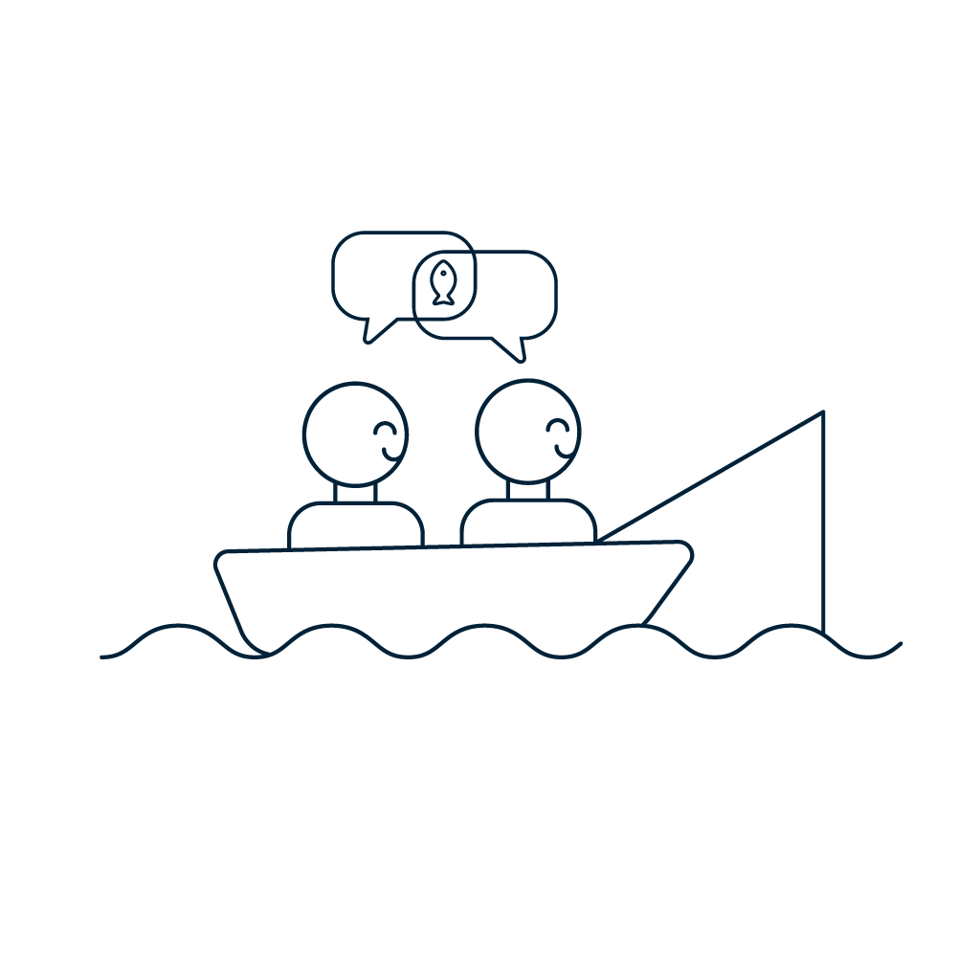
Welcome
Meet and greet
Agenda overview
Tasks for today

Slide 5
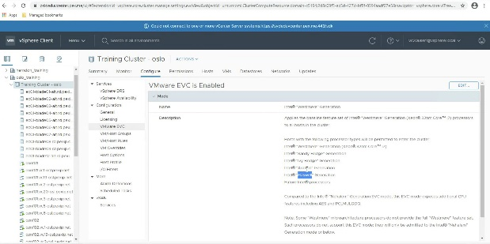


Agenda overview
Show then do
Day 1:
Morning :
Lab 1 - Introduction through to deployment – 2.5 hours
Afternoon :
Lab 2 - Interop through to Integration
– 2.5 hours
Day 2:
Morning :
Lab 3 - Media traversal and more integrations
– 2.5 hours
Afternoon:
Lab 4 - Join and UX
– 2 hours

Slide 6

Pexip Infinity: Planning to get it right
Recap on the fundamentals

Slide 7











Pexip Infinity: a cloud enterprise application
Virtualized
Distributed
Intelligent
Customizable
GCP
Notes:
Pexip Infinity is
Fully virtualised - Software only design
A fully distributed system
These three fundamentals of the product are what we set out to deliver in v1 of Pexip Infinity.
They enable Pexip to provide:
Control
Over your Data – Full control over where data is stored.
Over Admin rights – No need to share admin rights outside IT team.
Over Versioning – Banks, Federal agencies, and others, require control over versioning individually.
Quality of service
Because dedicated instances avoid one customer impacting the experience for other customers.
By leverage the scale and performance of the IaaS provider.
Integration
Easy integration with other IT assets such as directory and other infrastructure.
Customize look and feel to make this your system so blend in with your brand.
Cost Effectiveness
Cloud application model is becoming more common for large enterprises.
The distributed & elastic Infinity architecture keeps costs under control.
Large enterprises are already moving to IaaS providers.
Infinity is a driver for cloud adoption.
Infrastructure as a Service (virtualisation) provides the foundation on which Pexip is based. Pexip is then able to offer video based interoperability to standards based systems, Microsoft Skype for Business, Google Hangouts and WebRTC, plus integration with existing Enterprise infrastructure such as directory services (for example Active Directory), or legacy IPPBX and call control.
https://docs.pexip.com/admin/admin_intro.htm
https://docs.pexip.com/admin/customize_information.htm
https://docs.pexip.com/end_user/beginners_guide.htm
Virtualized - Entirely virtualized using cloud native APIs including cloud bursting. Run in private data center (on-premises) or in public clouds such as AWS, Azure and others. You can deploy across different hypervisors either in your data centres, or in a managed cloud data centre, or a combination of both. Whichever way you choose, you are in control of the data that flows through Pexip.
Distributed - Designed following modern IT fundamentals, Infinity is a cloud agnostic distributed system that scales resources according to usage and geography
Intelligent - Utilizes smart scaling and data routing for efficient data processing and intelligent transcoding of media to allow for the best experience independent of connection, technology and device
Customizable - Easy configuration, monitoring and troubleshooting provides IT team total control of the network and data. Easily customized to the company’s look and API, to be adopted to a business specific workflow

Slide 8
Infinity technology stacks
Management Node
Conferencing Nodes
Teams Connector Node
Linux (PexOS) based
Hosts admin web UI
Configure and create conferencing nodes
Configure services
Configure platform-wide and location specific policies
Monitor live calls / conferences
Aggregate conferencing node log data
Hosts management API
Optional
Windows server
Must be deployed in Azure
Includes both Pexip and Microsoft code.
Proxies media an signalling from conferencing node to Teams
Transcoding Role
Proxying Edge Role
Linux (PexOS) based
Grouped in locations
H323/SIP/WebRTC
Video and audio processing (Individual transcoding & transrating)
Requires a powerful CPU with no oversubscription
Optional
Linux (PexOS) based
Lightweight conferencing node
Proxies media to Conference nodes
Often deployed with one or two NICs
Less powerful CPU, but still no oversubscription
Notes:
Management Node
You need a management node before you do anything else. This is the configuration centre for an entire deployment.
This can be installed on an OnPrem hypervisor or in the cloud. Depending on the destination will depend on the steps you need to follow.
https://docs.pexip.com/admin/installing_management_node_vmware.htm
https://docs.pexip.com/admin/installing_management_node_hyperv.htm
https://docs.pexip.com/admin/installing_management_node_kvm.htm
https://docs.pexip.com/admin/installing_management_node_xen.htm
https://docs.pexip.com/admin/aws_management_node.htm
https://docs.pexip.com/admin/azure_management_node.htm
https://docs.pexip.com/admin/gcp_management_node.htm
You will obviously need to configure the hypervisor/cloud environment prior to deploying the management node to you should check out the documentation of each section.
Also see:
https://docs.pexip.com/admin/installation_overview.htm
https://docs.pexip.com/getting_started/decide_deployment_environment.htm
https://docs.pexip.com/admin/about_software_files.htm
Linux (PexOS) based
Django
Puppet
SQLite
Apache
Conferencing Nodes:
In most deployment scenarios, the Conferencing Nodes are created from the Management node. You simply configure the basic details of the conferencing node (such as IP details and static routes (if required)), and a VM image will be created for you, for your specific hypervisor. This means that the VM image simply needs to be deployed on the Hypervisor and as soon as it boots, it is ready to go. In some cases (such as AWS), you need to deploy a generic conferencing node, then apply a configuration file to the node.
https://docs.pexip.com/admin/creating_conferencing_nodes.htm
https://docs.pexip.com/admin/deploy_auto_vmware.htm
https://docs.pexip.com/admin/deploy_manual_vmware.htm
https://docs.pexip.com/admin/deploy_manual_hyper-v.htm
https://docs.pexip.com/admin/deploy_manual_kvm.htm
https://docs.pexip.com/admin/deploy_manual_xen.htm
https://docs.pexip.com/admin/aws_conferencing_node.htm
https://docs.pexip.com/admin/azure_conferencing_node.htm
https://docs.pexip.com/admin/gcp_conferencing_node.htm
As Pexip is a fully transcoding environment, you need at least one transcoding node in a deployment
Transcoding Role:
Linux (PexOS) based
Signalling stack (Python)
Application stack (Python)
Media stack (C, gstreamer)
Codecs (optimized ICC)
Proxy node deployment is the same as the transcoding nodes, although the role is optional. In fact, this it the same software image with a subtle teak to its configuration.
https://docs.pexip.com/admin/distributed_edge.htm
Also see:
https://docs.pexip.com/admin/edge_guidelines.htm
Proxying Edge Role:
Linux (PexOS) based
Lightweight conferencing node
No transcoding but decrypt / encrypt
Teams Connector Node:
Windows server
Application stack (C#, Graph SDK)
Media stack (C, gstreamer)

Slide 9
Infinity technology stacks
Conferencing Nodes
Teams Connector Node
Required
Optional
Required
Optional
Notes:
Management Node
You need a management node before you do anything else. This is the configuration centre for an entire deployment.
This can be installed on an OnPrem hypervisor or in the cloud. Depending on the destination will depend on the steps you need to follow.
https://docs.pexip.com/admin/installing_management_node_vmware.htm
https://docs.pexip.com/admin/installing_management_node_hyperv.htm
https://docs.pexip.com/admin/installing_management_node_kvm.htm
https://docs.pexip.com/admin/installing_management_node_xen.htm
https://docs.pexip.com/admin/aws_management_node.htm
https://docs.pexip.com/admin/azure_management_node.htm
https://docs.pexip.com/admin/gcp_management_node.htm
You will obviously need to configure the hypervisor/cloud environment prior to deploying the management node to you should check out the documentation of each section.
Also see:
https://docs.pexip.com/admin/installation_overview.htm
https://docs.pexip.com/getting_started/decide_deployment_environment.htm
https://docs.pexip.com/admin/about_software_files.htm
Linux (PexOS) based
Django
Puppet
SQLite
Apache
Conferencing Nodes:
In most deployment scenarios, the Conferencing Nodes are created from the Management node. You simply configure the basic details of the conferencing node (such as IP details and static routes (if required)), and a VM image will be created for you, for your specific hypervisor. This means that the VM image simply needs to be deployed on the Hypervisor and as soon as it boots, it is ready to go. In some cases (such as AWS), you need to deploy a generic conferencing node, then apply a configuration file to the node.
https://docs.pexip.com/admin/creating_conferencing_nodes.htm
https://docs.pexip.com/admin/deploy_auto_vmware.htm
https://docs.pexip.com/admin/deploy_manual_vmware.htm
https://docs.pexip.com/admin/deploy_manual_hyper-v.htm
https://docs.pexip.com/admin/deploy_manual_kvm.htm
https://docs.pexip.com/admin/deploy_manual_xen.htm
https://docs.pexip.com/admin/aws_conferencing_node.htm
https://docs.pexip.com/admin/azure_conferencing_node.htm
https://docs.pexip.com/admin/gcp_conferencing_node.htm
As Pexip is a fully transcoding environment, you need at least one transcoding node in a deployment
Transcoding Role:
Linux (PexOS) based
Signalling stack (Python)
Application stack (Python)
Media stack (C, gstreamer)
Codecs (optimized ICC)
Proxy node deployment is the same as the transcoding nodes, although the role is optional. In fact, this it the same software image with a subtle teak to its configuration.
https://docs.pexip.com/admin/distributed_edge.htm
Also see:
https://docs.pexip.com/admin/edge_guidelines.htm
Proxying Edge Role:
Linux (PexOS) based
Lightweight conferencing node
No transcoding but decrypt / encrypt
Teams Connector Node:
Windows server
Application stack (C#, Graph SDK)
Media stack (C, gstreamer)

Slide 10
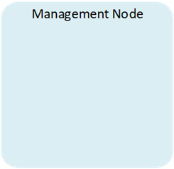
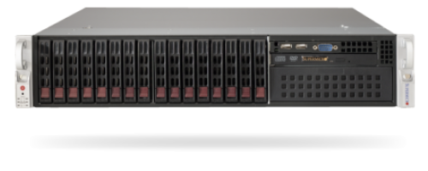
Basic Infinity deployment
DMZ
T
Public CA

Slide 11

Third party cloud Integration
DMZ
T
T
Public CA

Slide 12
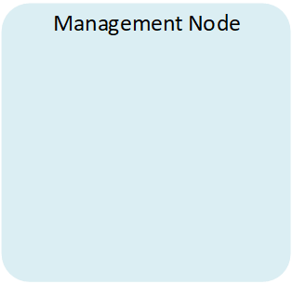

Cloud Bursting
DMZ
AWS
GCP
Azure
T
Public CA

Slide 13
Pexip Smart Scale
DMZ
Pexip Infinity: The Basics
GCP
PSS GW
T
Public CA

Slide 14
Distributed Architecture: Basics

Slide 15
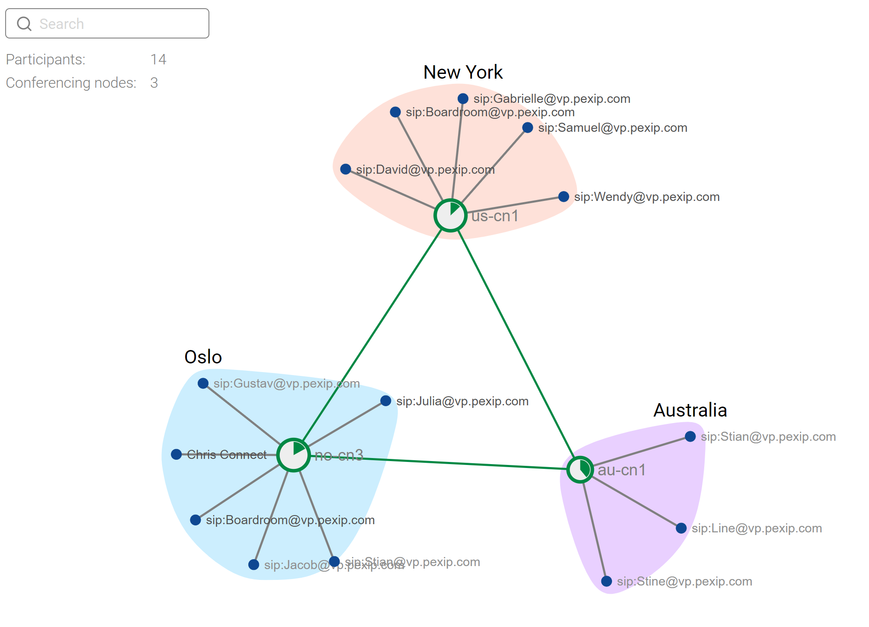
Distributed architecture in practice: 1
Example of a small distributed conference

Slide 16
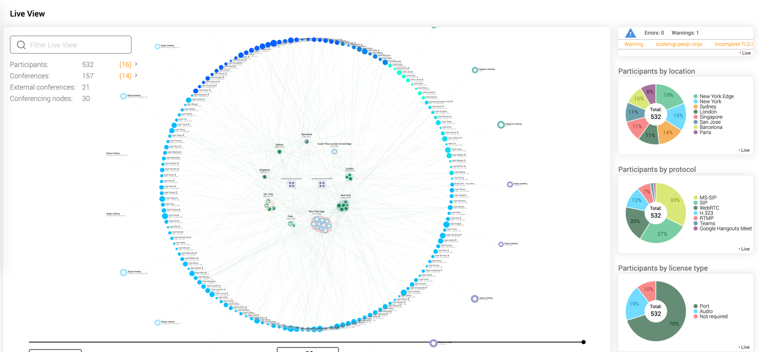
Distributed architecture in practice: 2
Example of enterprise client management node during a typical day
Notes:
This is a screenshot from a large mobile carrier’s management node during a typical day.
Pexip is an Enterprise application:
Designed to scale – designed for the cloud (be that private or managed).
Fully distributed, with intelligent “backplanes” forming between conference instances.
Designed to be secure. We use our own Linux OS (PexOS), which is loosely based on Debian but we control exactly what libraries, versions and patches are built into the product.
Designed to be customisable. We offer free facilities to enable enterprises and service providers full scope to white box and brand our products.
Simple for the user and for the admin.
The user does not have to change their workflow.
The admin sees dynamic visualisation of their deployment and only need to configure the business rules for their needs. Complex protocol handling and interoperability “just work”
https://docs.pexip.com/admin/dist_architecture.htm
https://docs.pexip.com/admin/infinity_architecture.htm
https://docs.pexip.com/admin/bandwidth_management.htm

Slide 17

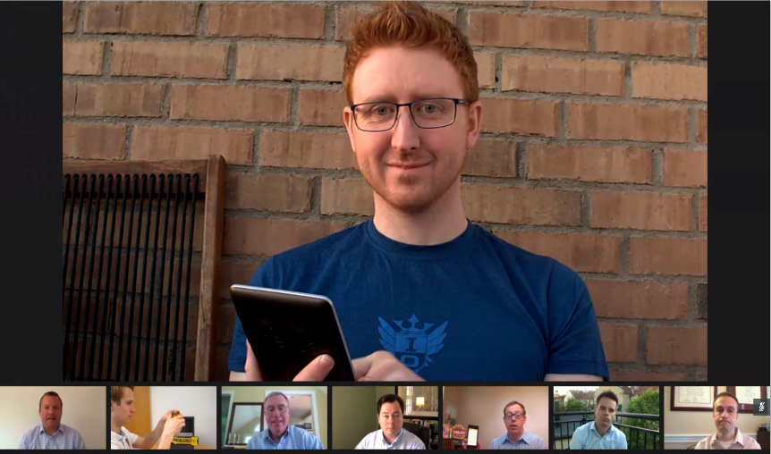
Distributed architecture: Backplanes and licencing
1
2
Scale capacity across multiple physical servers
Scale capacity across geographies
1
6
2
7
3
8
3
A
B
Reduce bandwidth usage through smart media routing
9
4
5
A3
1
4
Share licenses in a global pool – consume when and where needed
1
1
1
1
1
1
1
1
1
1
1
1
1
1
1
1
1
A1
B6
B7
A2
A4
A5
B8
port licenses
Notes:
Pexip’s architecture is unique. As a distributed system, you can deploy multiple software Virtualised Machines (nodes) across many physical servers (hosts), where each node works to add additional call capacity in a given location, and all the nodes act as a single videoconferencing system. Pexip can spread media across three nodes in and single location, for a given service. This takes some getting used to and understanding, and you will likely want to read, and probably re-read, and then re-read again our documentation pages on this.
https://docs.pexip.com/admin/infinity_architecture.htm
https://docs.pexip.com/admin/conference_distribution.htm
https://docs.pexip.com/admin/bandwidth_management.htm
As calls are placed between locations, so Pexip only sends the users streams and resolutions that are required in the remote location. The streams are then combine into a single video mix for the end device, meaning that Pexip can optimise bandwidth usage between those locations. In the layout above (1 + 7), we send one HD stream from the current talker (in location A) and several smaller streams for each of the previous speakers. In this way Pexip would only consume as a maximum of around 3MB of bandwidth between locations (assuming the this is an HD call).
You can deploy many software nodes (these are not charged by Pexip), however, you also need the physical hosts on which they run.
The software and hardware go together to create the “capacity” in order the calls can be placed. However, the licenses “allow” the calls to be placed. The licenses are where you spend your money. Effectively, a port license allows a video connection. In the above conference there are 9 devices connected, so 9 port licenses required. These come from a shared pool, using Pexip’s distributed technology.

Slide 18
Server Design – Getting it right at the start: No.1 Support Issue

Slide 19
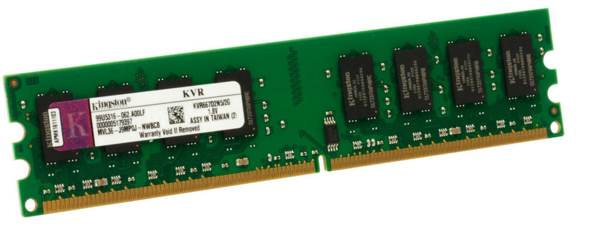
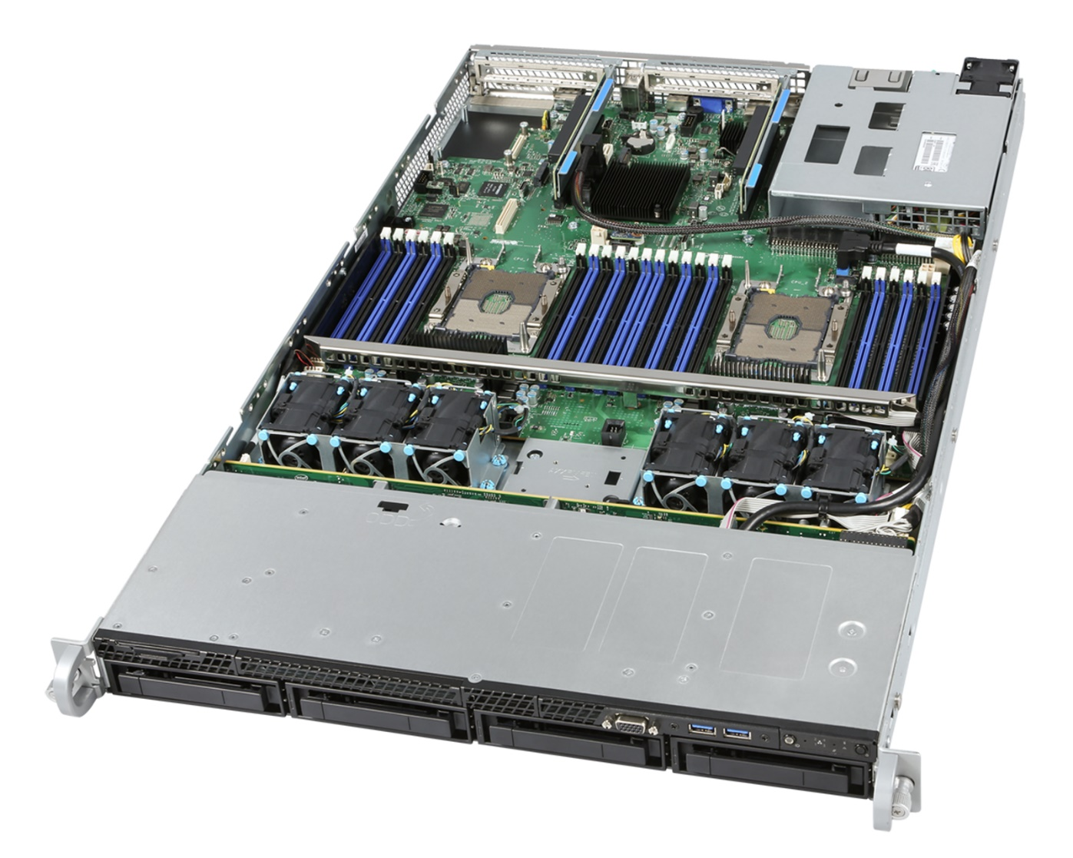

Server Design: Sockets and memory channels
Notes:
A server will have at a motherboard with at least one socket populated with a physical CPU. Along with the CPU, the server requires physical DIMMs, and for Pexip to function well, you should ensure that all the memory channels for that CPU are populated with a physical DIMM. For Intel Xeon v2 CPU, there are 6 memory channels per CPU, for earlier Xeon v1 CPU, there were 4 memory channels. Without fully populating the memory channels with DIMMs, you are limiting the memory bandwidth to the CPU which is likely to result in quality issues and possibly even call drops.
NOTE, the number of memory channels is NOT the same as the memory banks in a server. To maintain full memory speed, you should only populate 1 memory bank on all channels.
In most cases, the servers that are used to use Pexip use motherboards that can house two physical CPUs, so double the number of DIMMs are required.
BIOS settings should be set to Max performance, and sub-NUMA clustering should be disabled.
The entire https://docs.pexip.com/admin/server_design.htm section should be read thoroughly.

Slide 20
Server design: DO NOT OVER COMMIT host resources
VM 1 – 2 vCPUs
VM 2 – 2 vCPUs
Core 0
Core 1
Core 2
Core 3
VM 5 – 10 vCPUs
Now all over-committed.
VM 3 – 4 vCPUs
Core 4
Core 5
Core 6
Core 7
VM 4 – 2 vCPUs
Core 8
Core 9
Notes:
Pexip does not support overcommitting of RAM and CPU resources within a host, by this I mean that we do not co-exist well with other VMs running on the same host that may use the resources allocated to Pexip. Running additional VMs on host sockets that are in use by Pexip results in the hypervisor time slicing between the VMs. This will also reflect in poor performance. Pexip is a very CPU intensive platform, and the reason for virtualisation in our case is more related to hardware abstraction rather than a traditional VM administrators point of view to share resources. Of course, for this reason, this is often initially disliked by VM administrators, until they see the flexibility of the platform :). We would generally recommend specifying a dedicated host/s to run Pexip. Further, if you use vMotion with EVC (or similar technologies), this can also cause issues and is covered in the linked documentation.
https://docs.pexip.com/admin/server_design.htm,
https://docs.pexip.com/admin/configuring_vmware.htm
https://docs.pexip.com/admin/vmware_esxi_administration.htm

Slide 21
Server design: Pexip will use dedicated host resources
Core 0
Core 1
Core 2
Core 3
VM 1 (Transcoding role node) – 10 vCPUs
Core 4
Core 5
Core 6
Core 7
Core 8
Core 9
Notes:
Pexip MUST be deployed on dedicated resources. For example, a single conferencing node would usually consume an entire socket of a server meaning that no other VM should be deployed on the same host.

Slide 22
Server design: Pexip will use dedicated host resources
Core 0
Core 1
VM 1 (Proxying Edge role node) – 4 vCPUs
Core 2
Core 3
Core 4
Core 5
VM 2 (Proxying Edge role node) – 4 vCPUs
Core 6
Core 7
Core 8
Core 9
Notes:
Pexip MUST be deployed on dedicated resources. For example, a single conferencing node would usually consume an entire socket of a server meaning that no other VM should be deployed on the same host.

Slide 23
Server design: Pexip will use dedicated host resources
Core 0
Core 1
Core 0
Core 1
HT 0
HT 1
Core 2
Core 3
Core 2
Core 3
HT 2
HT 3
VM 1 (Transcoding role node) – 20 vCPUs
Core 4
Core 5
Core 4
Core 5
HT 4
HT 5
Core 6
Core 7
Core 6
Core 7
HT 6
HT 7
Core 8
Core 9
Core 8
Core 8
Core 9
HT 8
HT 9
Notes:
Modern CPUs use hyperthreading, meaning that we can double the vCPU count of a node. This may gain 50% additional capacity.

Slide 24
Server design: Pexip will use dedicated host resources
Core 0
HT 0
Core 1
HT 1
VM 1 (Proxying Edge role node) – 4 vCPUs
VM 2 (Proxying Edge role node) – 4 vCPUs
Core 2
HT 2
Core 3
HT 3
Core 4
HT 4
Core 5
HT 5
VM 3 (Proxying Edge role node) – 4 vCPUs
VM 4 (Proxying Edge role node) – 4 vCPUs
Core 6
HT 6
Core 7
HT 7
Core 8
Core 9
Core 8
VM 5 (Proxying Edge role node) – 4 vCPUs
HT 8
HT 9
Notes:
Modern CPUs use hyperthreading, meaning that we can double the vCPU count of a node. This may gain 50% additional capacity.

Slide 25
Server design: NUMA
NUMA 0
NUMA 1
Core 0
Core 1
Core 0
Core 1
Core 2
Core 3
Core 2
Core 3
Core 4
Core 5
Core 4
Core 5
Core 6
Core 7
Core 6
Core 7
VM 1 (Pexip) – 20 vCPUs
Core 8
Core 9
Core 8
Core 9
Notes:
NUMA (Non Uniform Memory Access) is a way of clustering multiple CPUs in a single server with associated memory. Whilst process running on one physical processor could access memory associated with another physical processor, this is much slower than a process accessing its own local memory. Clustering a CPU and its local memory together is consider to be a “NUMA node”.
You could deploy one large VM to consume all the cores on both sockets, however there is a problem. It is possible that a process running on one core in one NUMA node, will need to access memory attached to the other NUMA node. Whilst this is possible, the NUMA bus connecting the nodes is much slower and for a real time applications like Pexip, it will lead to delays in processing video frames and ultimately a poor experience for the users (such as quality issues or even call drops).

Slide 26
Server design: NUMA
NUMA 0
NUMA 1
Core 0
Core 1
Core 0
Core 1
Core 0
Core 1
HT 0
HT 1
Core 0
Core 1
HT 0
HT 1
Core 2
Core 3
Core 2
Core 3
Core 2
Core 3
HT 2
HT 3
Core 2
Core 3
HT 2
HT 3
Core 4
Core 5
Core 4
Core 5
Core 4
Core 5
HT 4
HT 5
Core 4
Core 5
HT 4
HT 5
VM 1 (Transcoding)
10 vCPUs
No NUMA Affinity
Core 6
Core 7
Core 6
Core 7
Core 6
Core 7
HT 6
HT 7
Core 6
Core 7
HT 6
HT 7
VM 2 (Transcoding)
10 vCPUs
No NUMA Affinity
Core 8
Core 9
Core 8
Core 9
Core 8
Core 9
HT 8
HT 9
Core 8
Core 9
HT 8
HT 9
Notes:
To ensure that things do not cross NUMA boundaries, it is simplest to think of each NUMA node as a separate machine and deploy 1 VM per NUMA node. If you ignore hyperthreading and simply map the physical core count to the number of vCPUs assigned to a VM, this is straightforward as the hypervisor manages this assignment effectively.

Slide 27
Server design: NUMA and Hyperthreading
NUMA 0
NUMA 1
Core 0
Core 1
Core 0
Core 1
Core 0
Core 1
HT 0
HT 1
Core 0
Core 1
HT 0
HT 1
Core 2
Core 3
Core 2
Core 3
Core 2
Core 3
HT 2
HT 3
Core 2
Core 3
HT 2
HT 3
Core 4
Core 5
Core 4
Core 5
Core 4
Core 5
HT 4
HT 5
Core 4
Core 5
HT 4
HT 5
Core 6
Core 7
Core 6
Core 7
VM 1 (Transcoding)
20 vCPUs
NUMA Affinity Set
Core 6
Core 7
HT 6
HT 7
Core 6
Core 7
HT 6
HT 7
VM 2 (Transcoding)
20 vCPUs
NUMA Affinity Set
Core 8
Core 9
Core 8
Core 9
Core 8
Core 9
HT 8
HT 9
Core 8
Core 9
HT 8
HT 9
Notes:
When creating a VM with a vCPU count that is greater than the number of physical cores on a processor, we can’t be sure that the hypervisor will automatically locate processes for that VM to run on a single NUMA node, so we could end up with the issues as seen in the previous slide where a process of one NUMA node may access recourse on another. We therefore need to add additional configuration to the VM to lock it to a specific NUMA node. This is known as NUMA pinning or NUMA affinity.

Slide 28
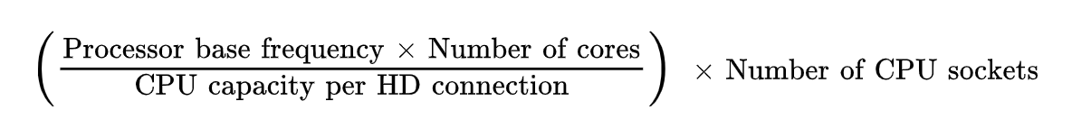
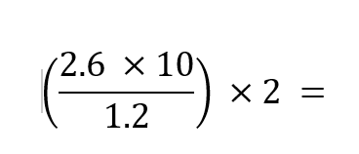
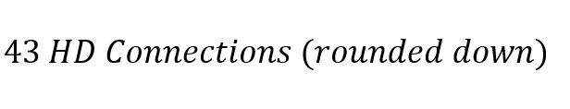
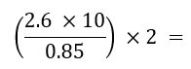
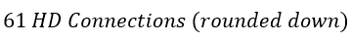
Server design: rule of thumb compute port calculation
What CPU? (e.g E5-2660 v3 dual socket server) - Google Intel Ark database
Number of sockets? (e.g. 2)
Number of cores (e.g. 10)
Base frequency (e.g. 2.6 GHz)
Are you using NUMA affinity?
No: CPU capacity per HD connection = 1.2
Yes: CPU capacity per HD connection = 0.85
Then….
So for No NUMA Affinity….
And for NUMA Affinity…..
Notes:
The “CPU Capacity per HD connection” has been determined through empirical QA testing. Dividing by 0.85 gives approximately a 50% higher value than dividing by 1.2. Through testing, we have determined that employing hyperthreading, we can gain around a 50% increase in performance.

Slide 29
Server design: without NUMA affinity (E5 series)
Pexip Conf 01 14 vCPU – 14 GB RAM
Pexip Conf 02 14 vCPU – 14 GB RAM
Hypervisor: VMware / Hyper-V / Xen / KVM
Server
E5-2680v4 14 core @ 2.4 GHz
E5-2680v4 14 core @ 2.4 GHz
Server notes
BIOS settings: Max performance
All mem CHANNELS populated, normally 4 channels per CPU for the Intel E5 series.
QPI
14 core x 2.4 GHz = 33.6 GHz 33.6 GHz / 1.2 GHz per HD = ~28 HD per CPU With 2 x CPUs, 2 x 28 HD = 56 HD per server
Notes:
QPI - Intel QuickPath Interconnect - a point-to-point processor interconnect developed by Intel which replaced the front-side bus (FSB) in Xeon, Itanium, and certain desktop platforms starting in 2008.

Slide 30
Server design: with NUMA affinity (E5 series)
Pexip Conf 01 28 vCPU – 28 GB vRAM
Pexip Conf 02 28 vCPU – 28 GB vRAM
Hypervisor Affinity
- Verify expected capacity without NUMA as per previous slide (verify BIOS performance & RAM)
Force each VM on the server to a walled garden of one CPU by setting NUMA affinity
Tag each VM with numa_cpuX to more easily remember setup.
Hypervisor: Affinity set to VM for cpu0
Hypervisor: Affinity set to VM for cpu1
Server
E5-2680v4 14 core @ 2.4 GHz
E5-2680v4 14 core @ 2.4 GHz
QPI
14 core x 2.4 GHz = 33.6 GHz 33.6 GHz / 0.85 GHz per HD = ~40 HD per CPU With 2 x CPUs, 2 x 40 HD = 80 HD per server

Slide 31
Server design: without NUMA affinity (Gold/Platinum series)
Pexip Conf 01 20 vCPU – 20 GB RAM
Pexip Conf 02 20 vCPU – 20 GB RAM
Hypervisor: VMware / Hyper-V / Xen / KVM
Server
Gold 6148 20 core @ 2.4 GHz
Gold 6148 20 core @ 2.4 GHz
Server notes
BIOS settings: Max performance
All mem CHANNELS populated, normally 6 per CPU of the Gold/ Platinum Series.
UPI
20 core x 2.4 GHz = 48 GHz 48 GHz / 1.2 GHz per HD = ~40 HD per CPU With 2 x CPUs, 2 x 40 HD = 80 HD per server
Notes:
UPI - Intel® Ultra Path Interconnect (UPI) links are a high speed, point-to-point interconnect bus between the processors, delivering increased bandwidth and performance over Intel® QPI.

Slide 32
Server design: with NUMA affinity (Gold/Platinum series)
Pexip Conf 01 40 vCPU – 40 GB vRAM
Pexip Conf 02 40 vCPU – 40 GB vRAM
Hypervisor Affinity
Verify expected capacity without NUMA as per previous slide (verify BIOS performance & RAM)
Force each VM on the server to a walled garden of one CPU by setting NUMA affinity
Tag each VM with numa_cpuX to more easily remember setup.
Hypervisor: Affinity set to VM for cpu0
Hypervisor: Affinity set to VM for cpu1
Server
Gold 6148 20 core @ 2.4 GHz
Gold 6148 20 core @ 2.4 GHz
UPI
20 core x 2.4 GHz = 48 GHz 48 GHz / 0.85 GHz per HD = ~56 HD per CPU With 2 x CPUs, 2 x 56 HD = 112 HD per server

Slide 33
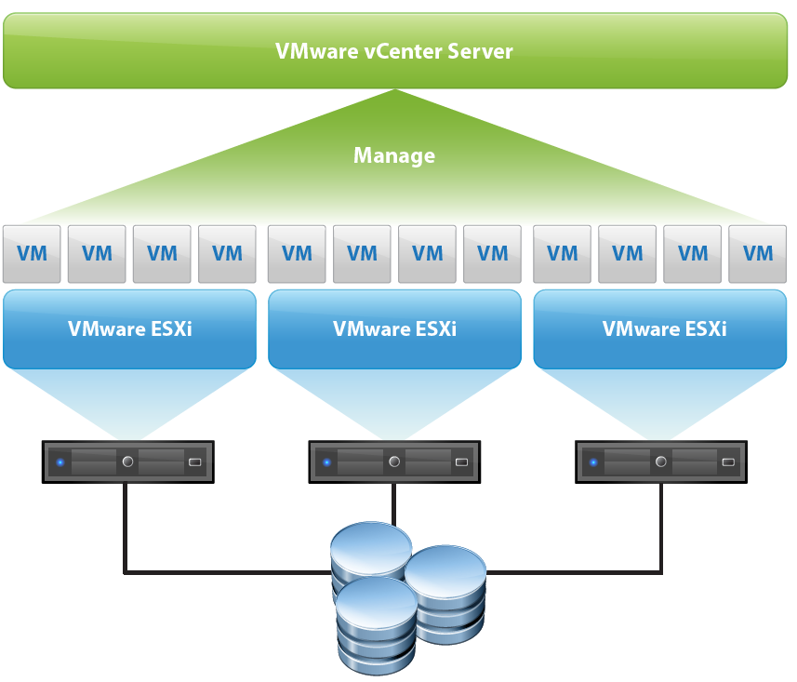

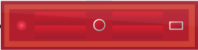
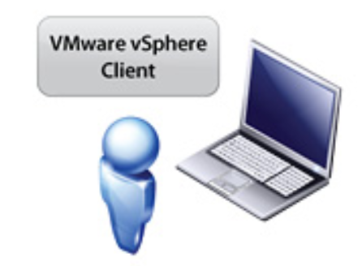
Virtualised high availability
VMware key features
vMotion
High availability
Fault tolerance
Data protection (auto backup)
Storage vMotion
Intranet
Mgr
Conf-1
Conf-2
Conf-1
Conf-2
Mgr
Notes:
The above terminologies refers to VMware products although most hypervisor technologies will support similar operations.
HA allows VMs to be started on another physical server, when the original server fails. The could be a great thing to do automatically for the Management node, however, careful consideration needs to be applied to the Conferencing nodes to ensure that you do not lead to overcommitting your host hardware resources. Often then, the conferencing nodes will only be allocated to a host based on some manual input from the VM administrator.
https://docs.pexip.com/admin/vmware_esxi_administration.htm#high_availability

Slide 34
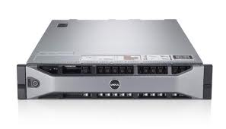
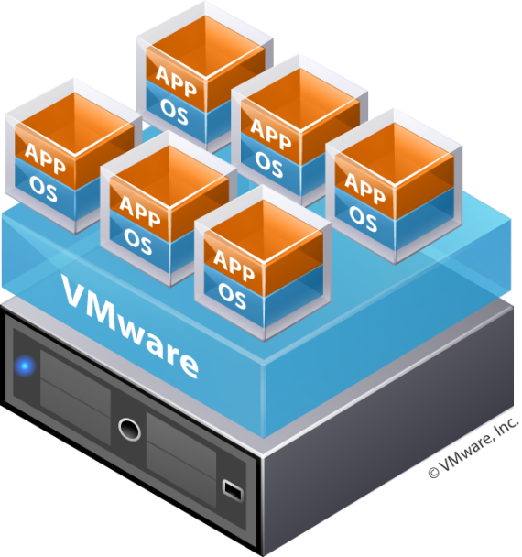
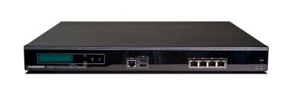
Pexip resilience: multiple layers
Hardware
Power, network, storage, servers, datacenters
VMware
vMotion, DRS, high availability, fault tolerance
Call control
Can point to multiple nodes per location
Pexip
Multiple independent nodes, distributed
Notes:
Distributed Resource Scheduler: monitors VM workloads and can relocate VMs to balance resources
High Availability monitoring for host-level failure and can relocate shared VMs located on a shared resource (such as a SAN)
Fault Tolerance creates and exact copy of a VM on another host for instant failover in event of failures.
https://docs.pexip.com/admin/resilience.htm

Slide 35
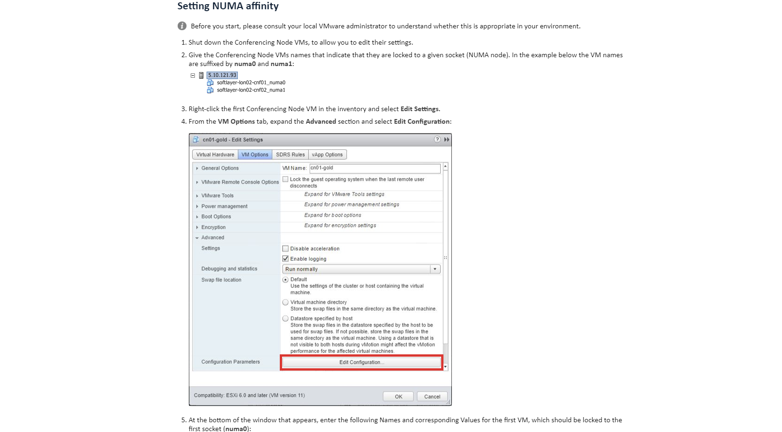
Set-up guidance
https://docs.pexip.com/server_design/vmware_numa_affinity.htm#setting

Slide 36
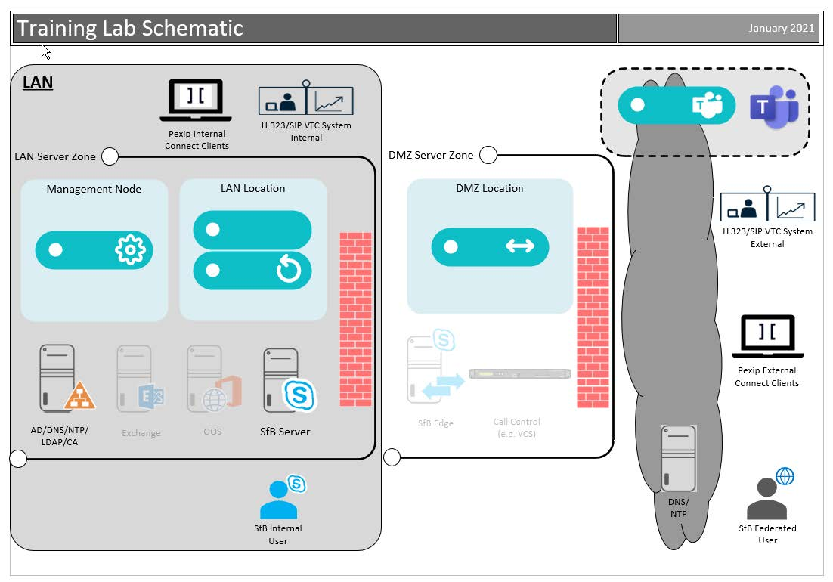
Deployment

Slide 37
Typical real-world redundant deployment
DMZ network zone
Edge Nodes – proxying external calls
4 vCPU / 4 GB RAM / 50 GB disk
Single or dual NIC for internal / external communication
Internal network zone
Transcoding Nodes – transcoding all calls
10+ vCPU / 10+ GB RAM / 50 GB disk
Management Node – managing the platform 4 vCPU / 4 GB RAM / 100 GB disk
Notes:
The components that are used in a typical production system:
https://docs.pexip.com/admin/infinity_components.htm

Slide 38
You lab deployment
DMZ network zone
1 x Edge Node – proxying external calls (initially installed in the Transcoding Role)
4 vCPU / 4 GB RAM / 50 GB disk
Single NIC with Public IP
Internal network zone
2 x Transcoding Nodes – transcoding all calls
4 and 8 vCPU / 4 and 8 GB RAM / 50 GB disk each
Management Node – managing the platform 4 vCPU / 4 GB RAM / 100 GB disk
Notes:
The lab replicates a typical OnPrem deployment, with external Proxying Edge nodes and internal Transcoding nodes plus the Management node.
https://docs.pexip.com/admin/infinity_components.htm

Slide 39

Manually deploying Pexip: all hypervisors
Configure Conf Node
Pexip Mgmt Node (4 vCPU)
Pexip Conf Node (10 vCPU)
Capacity ~20 HD
Pexip Conf Node (6 vCPU) Capacity ~16 HD
Pexip Conf Node (10 vCPU)
Capacity ~20 HD
Pexip Conf Node (10 vCPU)
Capacity ~20 HD
HyperV or VMware
HyperV or VMware
Deploy Conf Node
Dell/IBM/HP/Cisco etc 2x10-core
Dell/IBM/HP/Cisco etc 2x10-core
Download Conf Node
Deploy Mgmt Node
Notes:
As Pexip ONLY runs in a virtualised platform, the first thing you need to do is choose and deploy your hypervisor from our supported list. You can then deploy the different nodes on the hosts, being careful not to over commit your hardware resources (a mistake that is often made in new deployments).
In most cases, you only need to download the management node from the Pexip website. This comes as a VM image file, specific to each hypervisor (e.g. and OVA for VMware – see the slides previously).
You can then configure the basic details of the conferring nodes (such as IP details), and the management node to create an VM image file for you, which you can then deploy to the hypervisor. These are a ONE TIME USE ONLY file, so there is no point in keeping them after the node has been deployed. If you ever need to redeploy a node, even with the same details, you will create a new VM image.
Deploying more nodes means deploying to more hosts.
https://docs.pexip.com/getting_started/decide_deployment_environment.htm
https://docs.pexip.com/admin/hypervisor_support.htm
https://docs.pexip.com/admin/server_design.htm
https://docs.pexip.com/admin/about_software_files.htm

Slide 40

Let’s get started!

Slide 41
Lab 1 - Introduction through to deployment – 2.5 hours
Section 1 introduction and information you need to access the main lab environment.
Section 2 provides information about the deployment and integrations you will complete as part of this course.

Slide 42
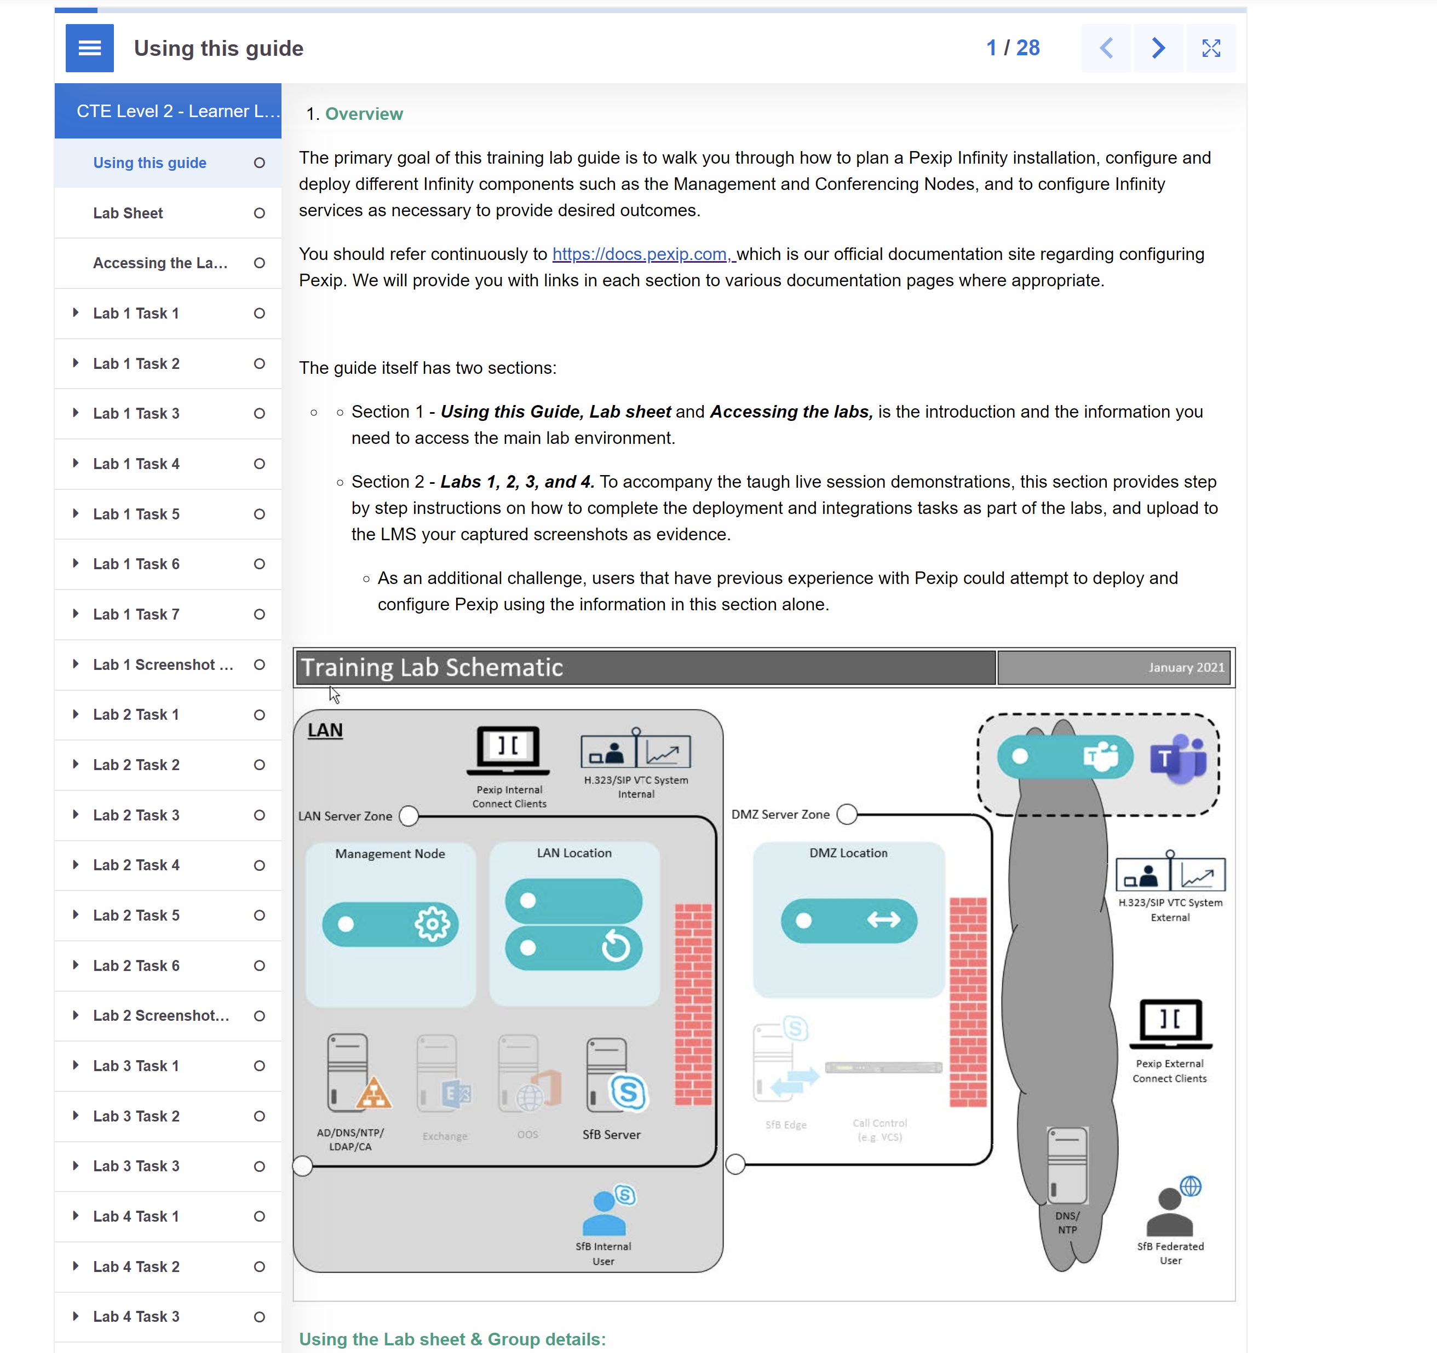
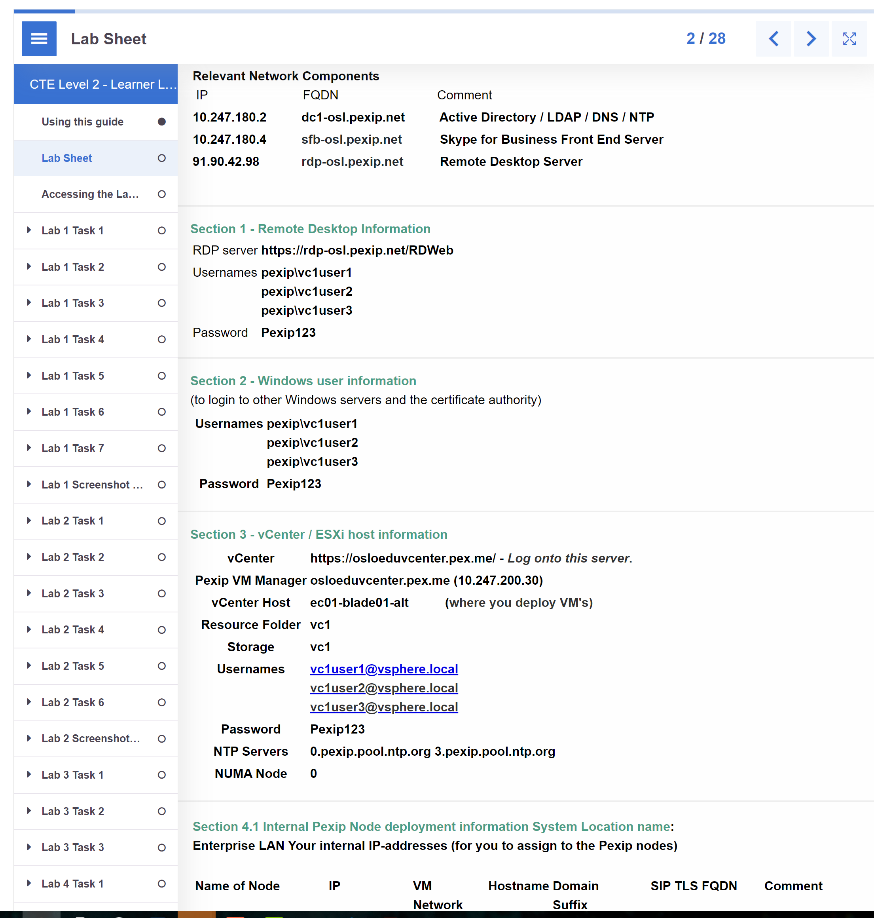



Section 1 1. Information to access the main lab environment.
Lab sheet
Workbook
Each group has a name:
vc1 or vc2,3,4,5,6,7,8,910
+ location
vc1-osl
+ a shared domain space:
pexip.net
= unique domain name space for each group’s lab :
vc01.pexip.net
Each Node also has a host name:
mgr
conf01
edge
Integrate your group domain to use these FQDNs to browse to the Node by name:
https://mgr.vc1.pexip.net https://edge.vc1.pexip.net
Passwords Pexip123

Slide 43
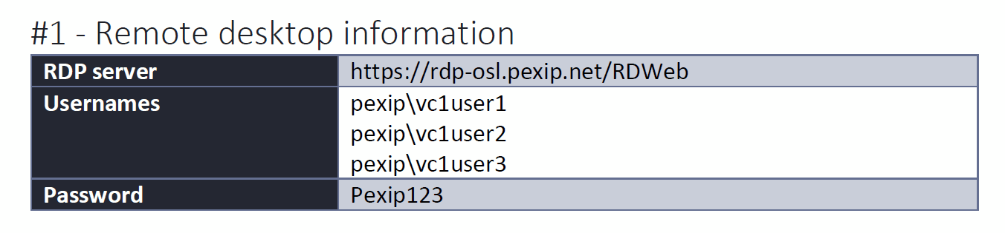
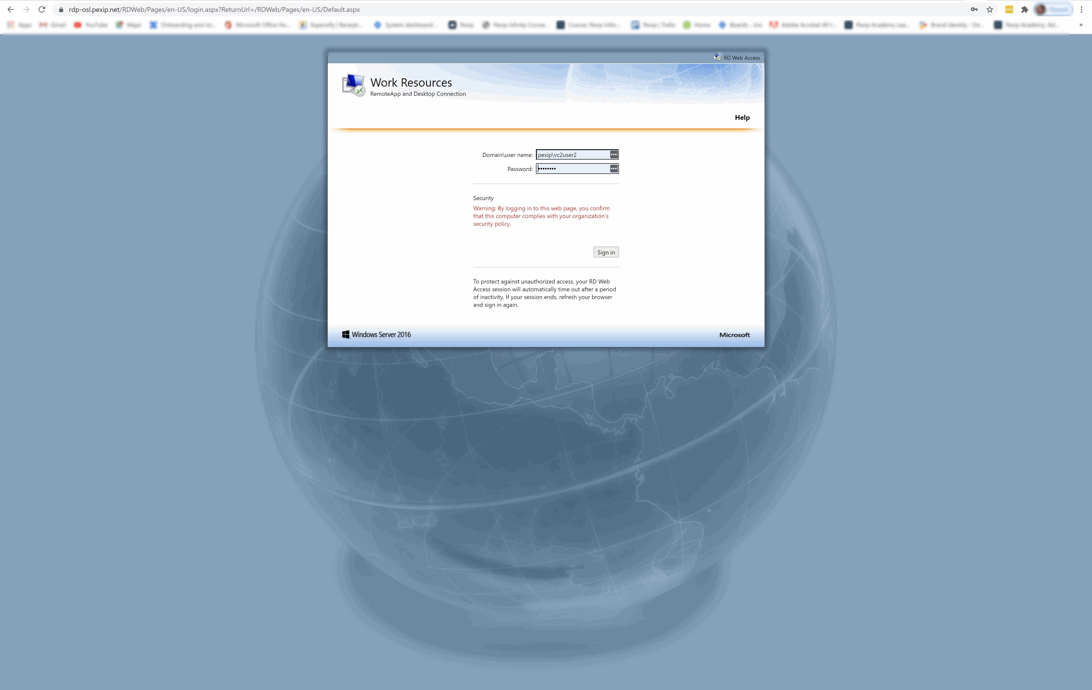
Section 1 3. Accessing the Lab Infrastructure
RDP
login to Remote Desktop - lab sheet section #1.
Via the browser, connect to the URL of the RDP server. a. Login with the username and password from your group’s Lab Sheet. (set language requirements via lab sheet)

Slide 44
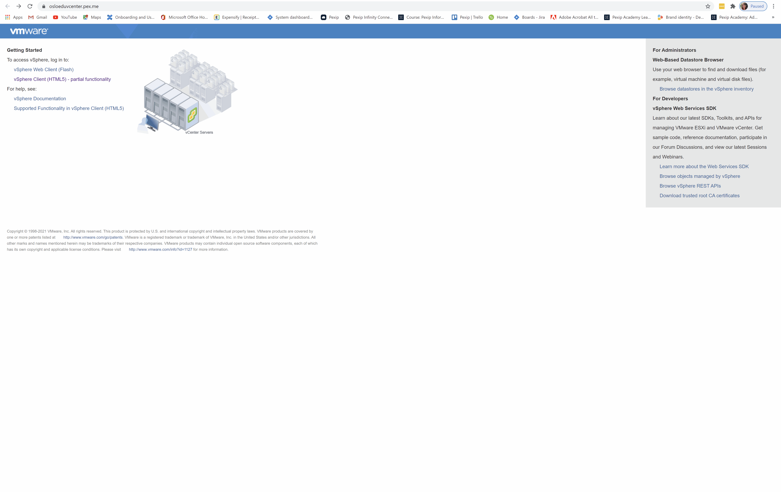

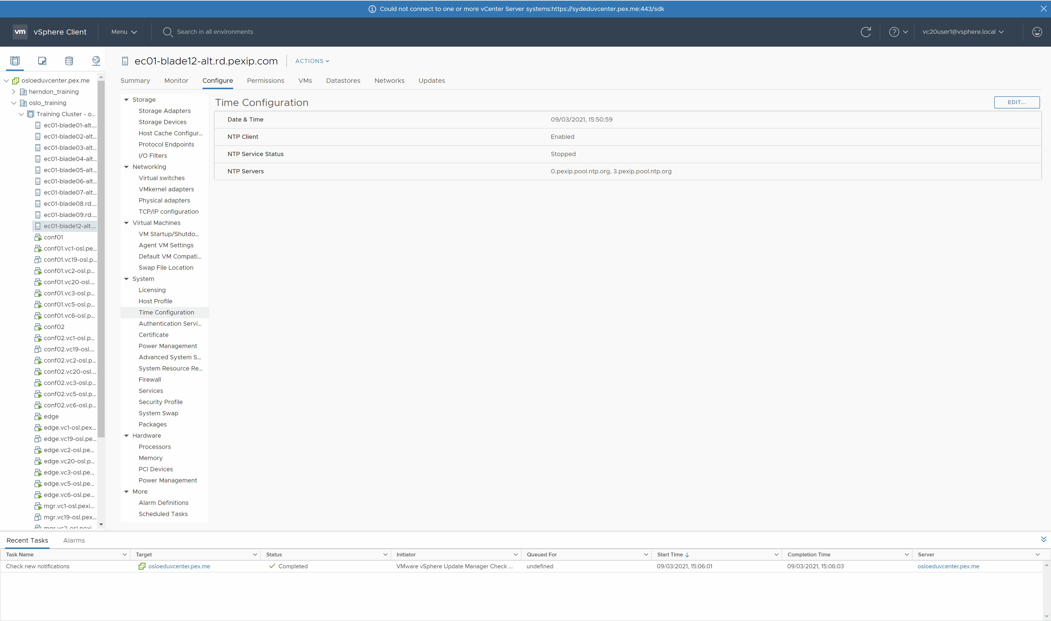
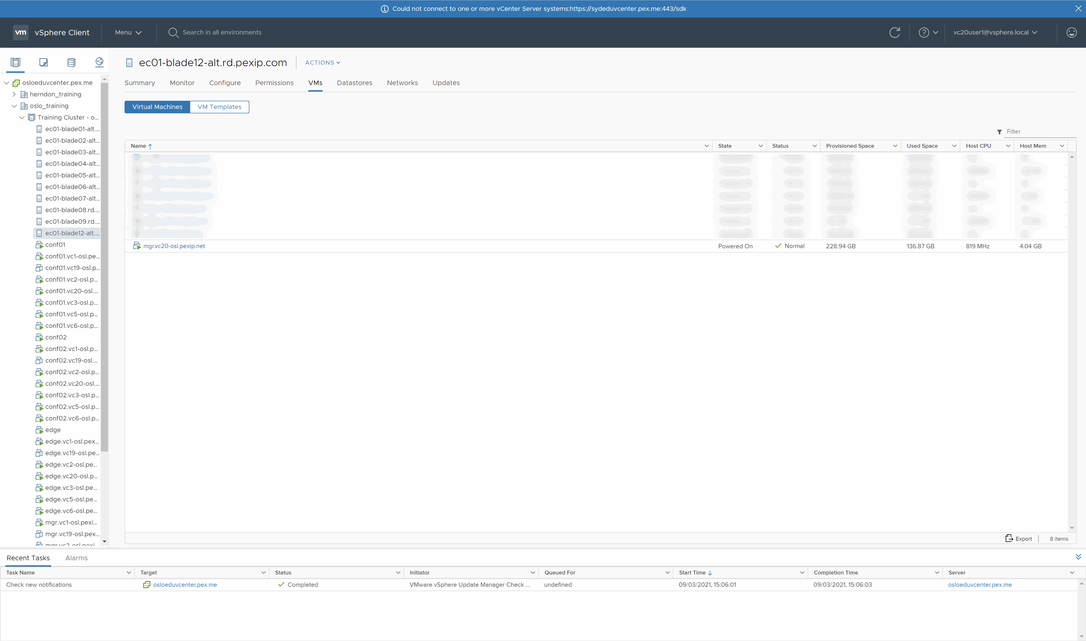
Section 2 1. Deploy the Management Node
Login to the vCenter using the HTML5 client option.
Setting the correct time
Deployment and initial configuration of the Management Node
Demonstrate your working Pexip Infinity deployment
Notes:
Use section #3 and section #4.1 of the lab sheet.
The Management Node is the first component you need to install in an Infinity deployment. It allows you to configure various Pexip Infinity services and integrations with other systems and provides a central point to view both ongoing and historical conferences. It also acts as a syslog server, providing a unified set of logs from all nodes in a deployment, including itself. It doesn’t take part in any conferencing duties, so no media or call signalling will pass through it. Currently, there is only one management node per Pexip Infinity deployment (although this may change in a later version). Every change you make on the management node takes up to 1 minute to replicate to other nodes in the deployment.
Pexip Infinity nodes run in a pure virtualised environment. You can think of a virtualised environment as having two main components:
• The host: this is the physical machine that is used to run the hypervisor.
• The guests: these are Virtual Machines (VMs) that run inside the hypervisor on the host.
In this lab we will use VMware ESXi as the hypervisor, but Pexip can run on many other hypervisors, both OnPrem and in the cloud (such as HyperV, Zen and KVM (all OnPrem), or Azure, GCP and AWS (in the cloud))

Slide 45
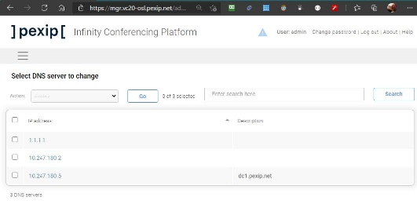
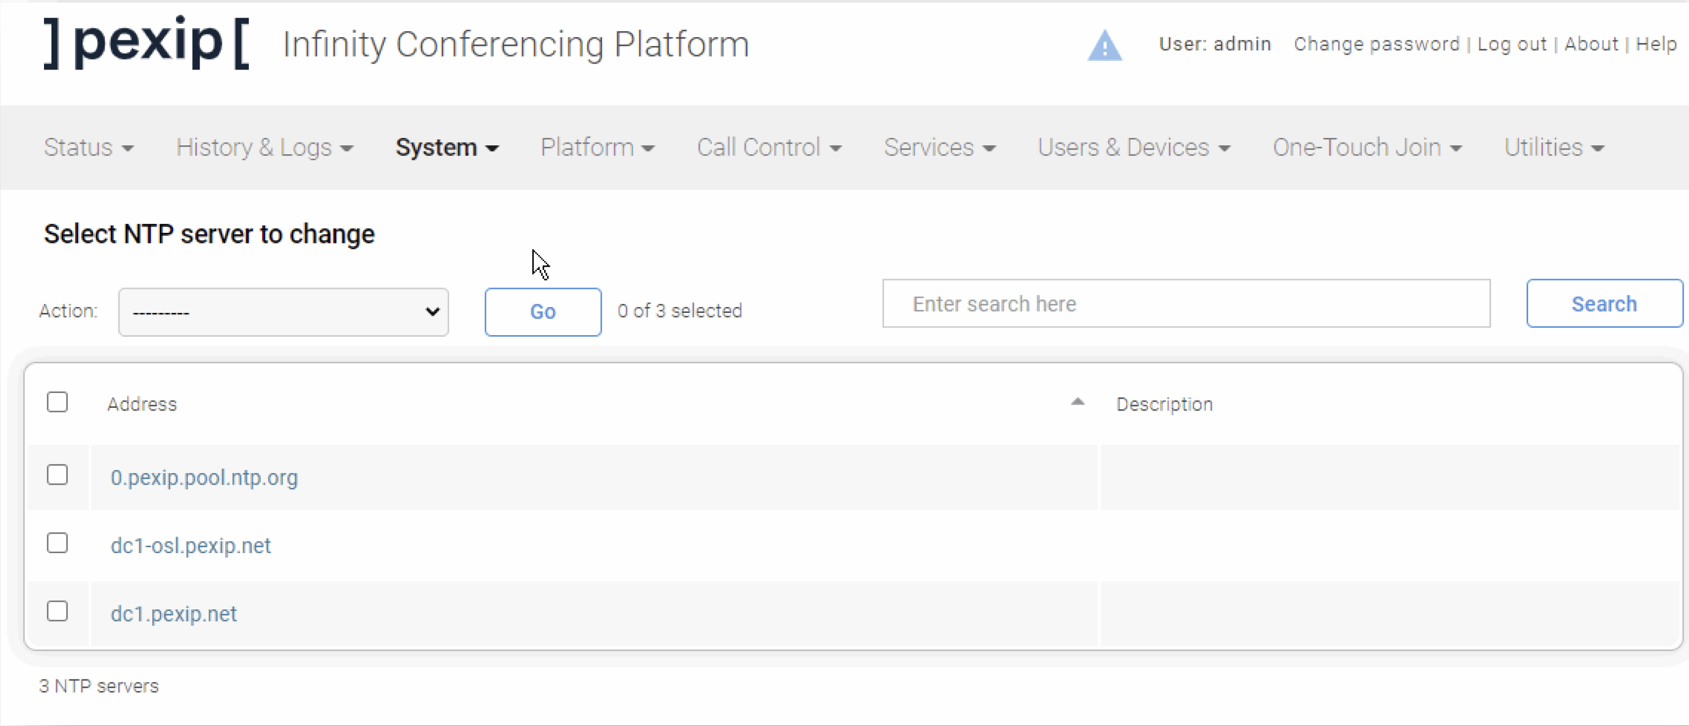
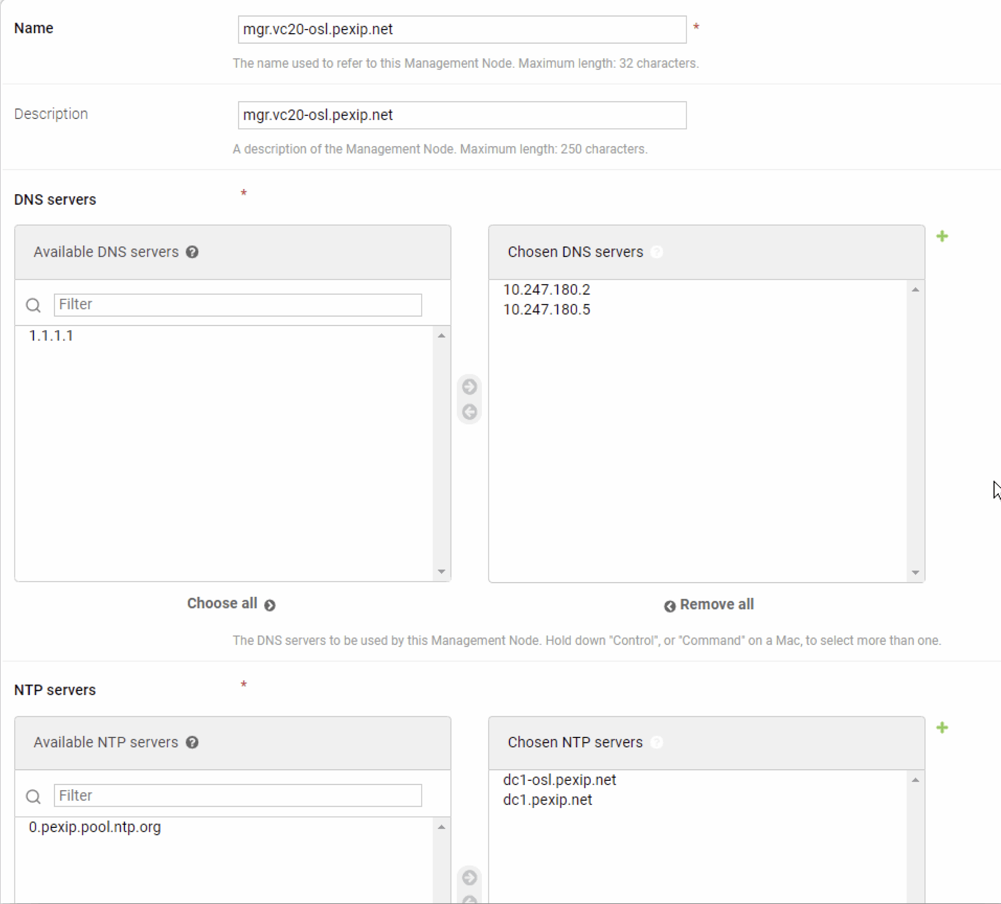

Section 2 2. Configure locations
DNS for the system
NTP for the System
DNS & NTP for mgr node
Demonstrate your working Pexip Infinity deployment
Notes:
Use section #3 and section #4.1 of the lab sheet.
The Management Node is the first component you need to install in an Infinity deployment. It allows you to configure various Pexip Infinity services and integrations with other systems and provides a central point to view both ongoing and historical conferences. It also acts as a syslog server, providing a unified set of logs from all nodes in a deployment, including itself. It doesn’t take part in any conferencing duties, so no media or call signalling will pass through it. Currently, there is only one management node per Pexip Infinity deployment (although this may change in a later version). Every change you make on the management node takes up to 1 minute to replicate to other nodes in the deployment.
Pexip Infinity nodes run in a pure virtualised environment. You can think of a virtualised environment as having two main components:
• The host: this is the physical machine that is used to run the hypervisor.
• The guests: these are Virtual Machines (VMs) that run inside the hypervisor on the host.
In this lab we will use VMware ESXi as the hypervisor, but Pexip can run on many other hypervisors, both OnPrem and in the cloud (such as HyperV, Zen and KVM (all OnPrem), or Azure, GCP and AWS (in the cloud))

Slide 46
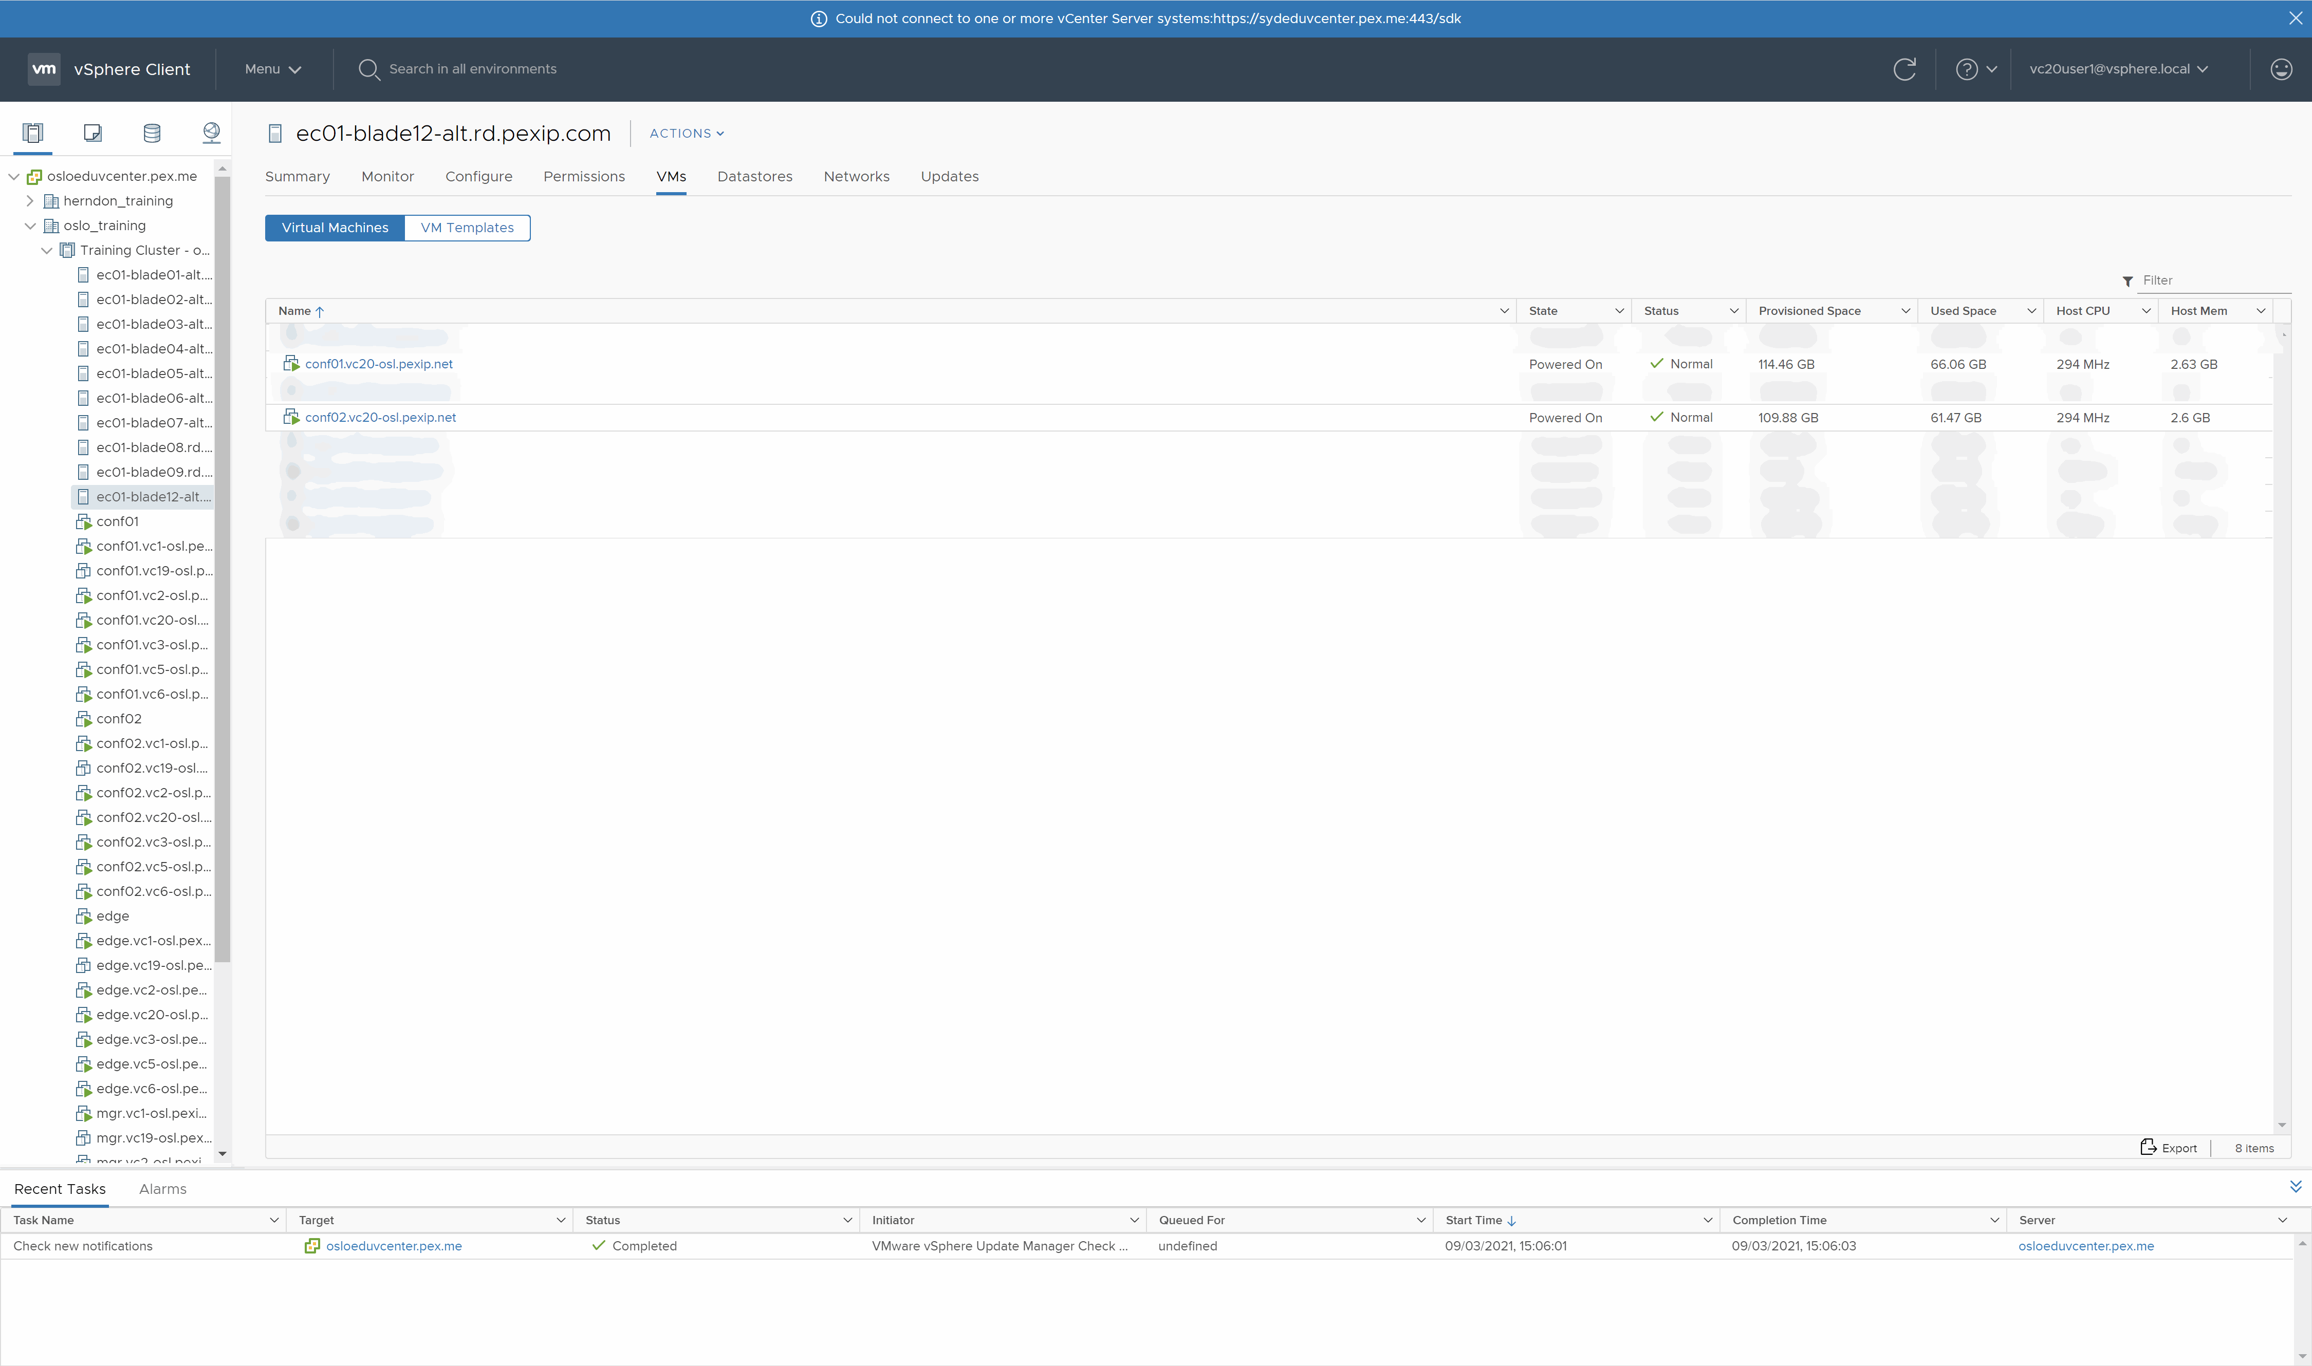
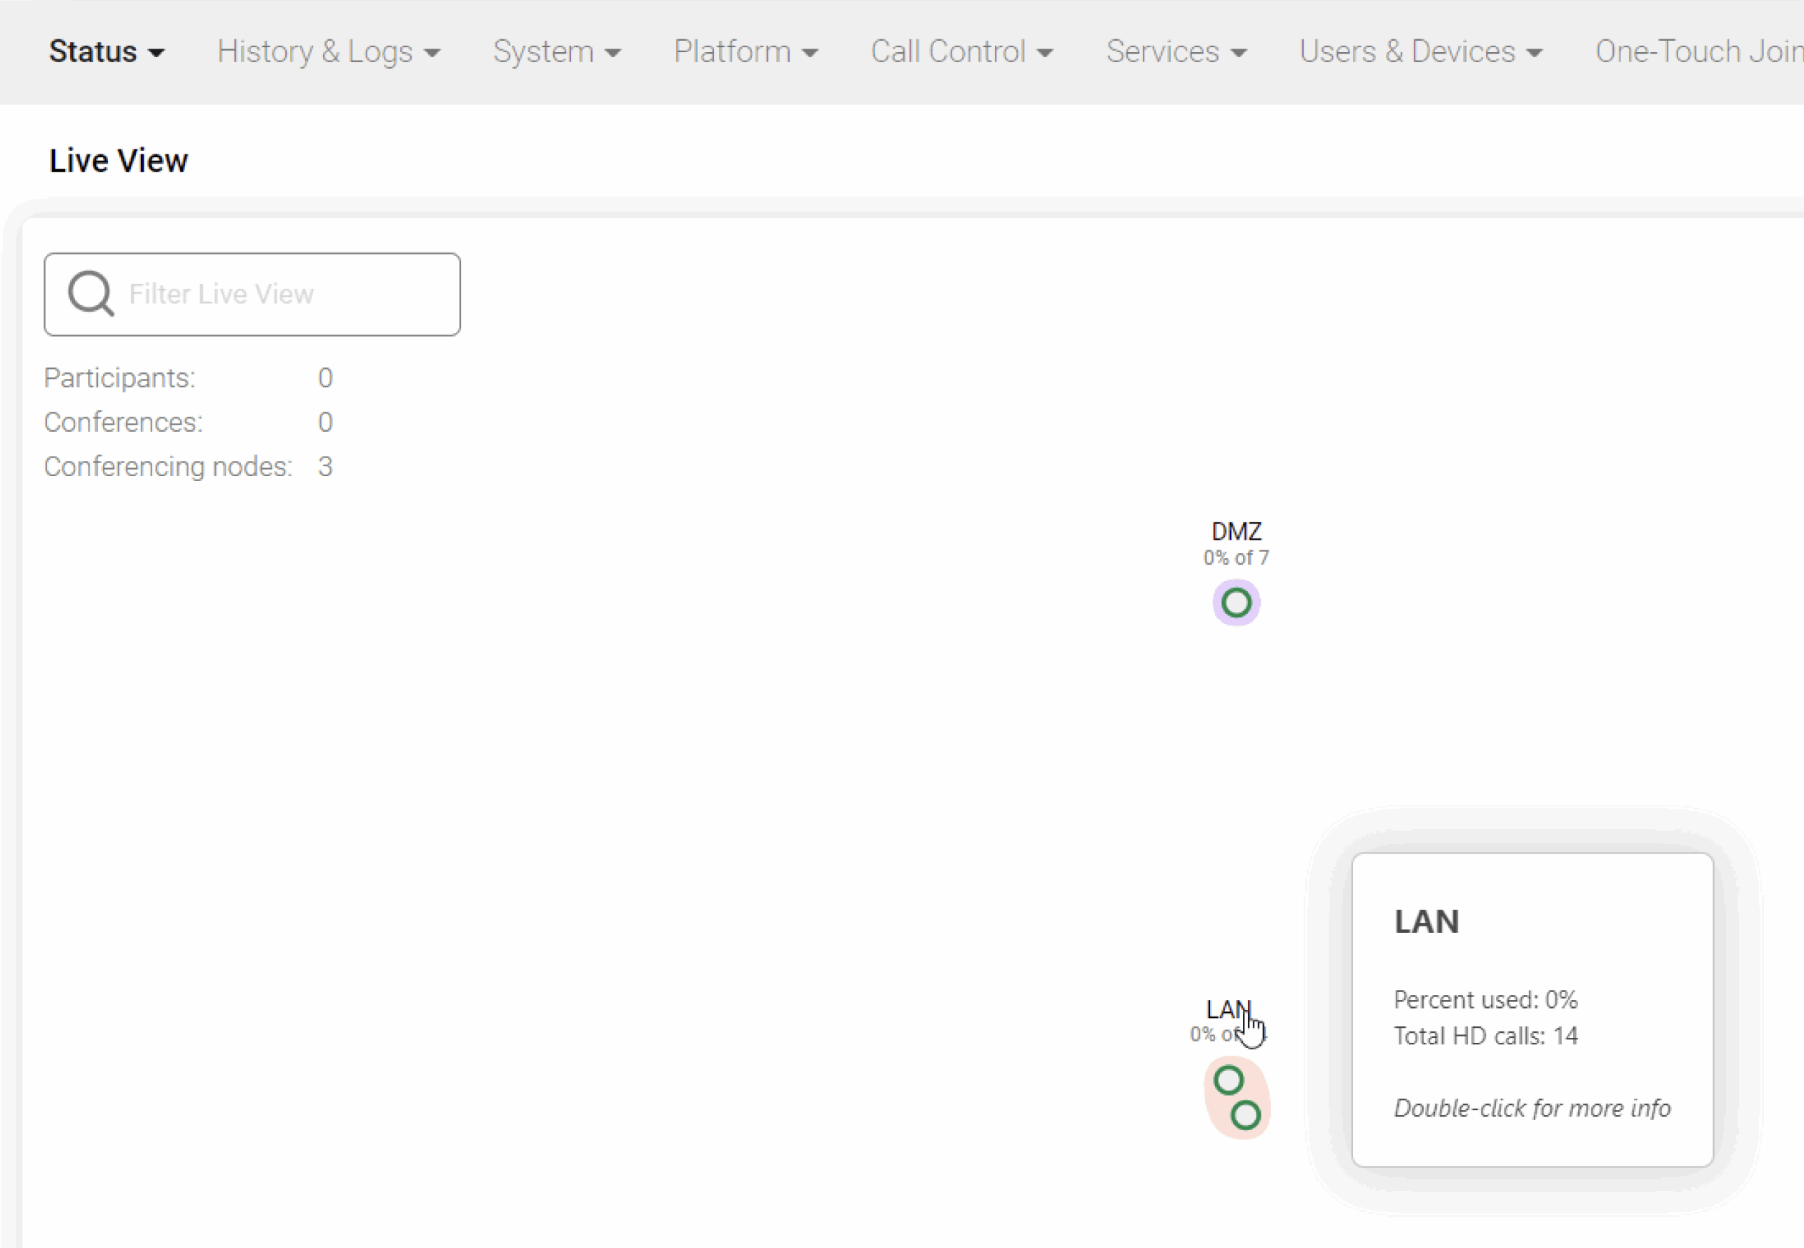
Section 2 3. Deploy Internal Pexip Transcoding Conferencing Nodes.
Each Node also has a host name:
mgr
conf01
edge
Deploy Internal Pexip Transcoding nodes x 2 (LAN)
Demonstrate your working Pexip Infinity deployment
Notes:
Use section #3 and section #4.1 of the lab sheet.
The Management Node is the first component you need to install in an Infinity deployment. It allows you to configure various Pexip Infinity services and integrations with other systems and provides a central point to view both ongoing and historical conferences. It also acts as a syslog server, providing a unified set of logs from all nodes in a deployment, including itself. It doesn’t take part in any conferencing duties, so no media or call signalling will pass through it. Currently, there is only one management node per Pexip Infinity deployment (although this may change in a later version). Every change you make on the management node takes up to 1 minute to replicate to other nodes in the deployment.
Pexip Infinity nodes run in a pure virtualised environment. You can think of a virtualised environment as having two main components:
• The host: this is the physical machine that is used to run the hypervisor.
• The guests: these are Virtual Machines (VMs) that run inside the hypervisor on the host.
In this lab we will use VMware ESXi as the hypervisor, but Pexip can run on many other hypervisors, both OnPrem and in the cloud (such as HyperV, Zen and KVM (all OnPrem), or Azure, GCP and AWS (in the cloud))

Slide 47

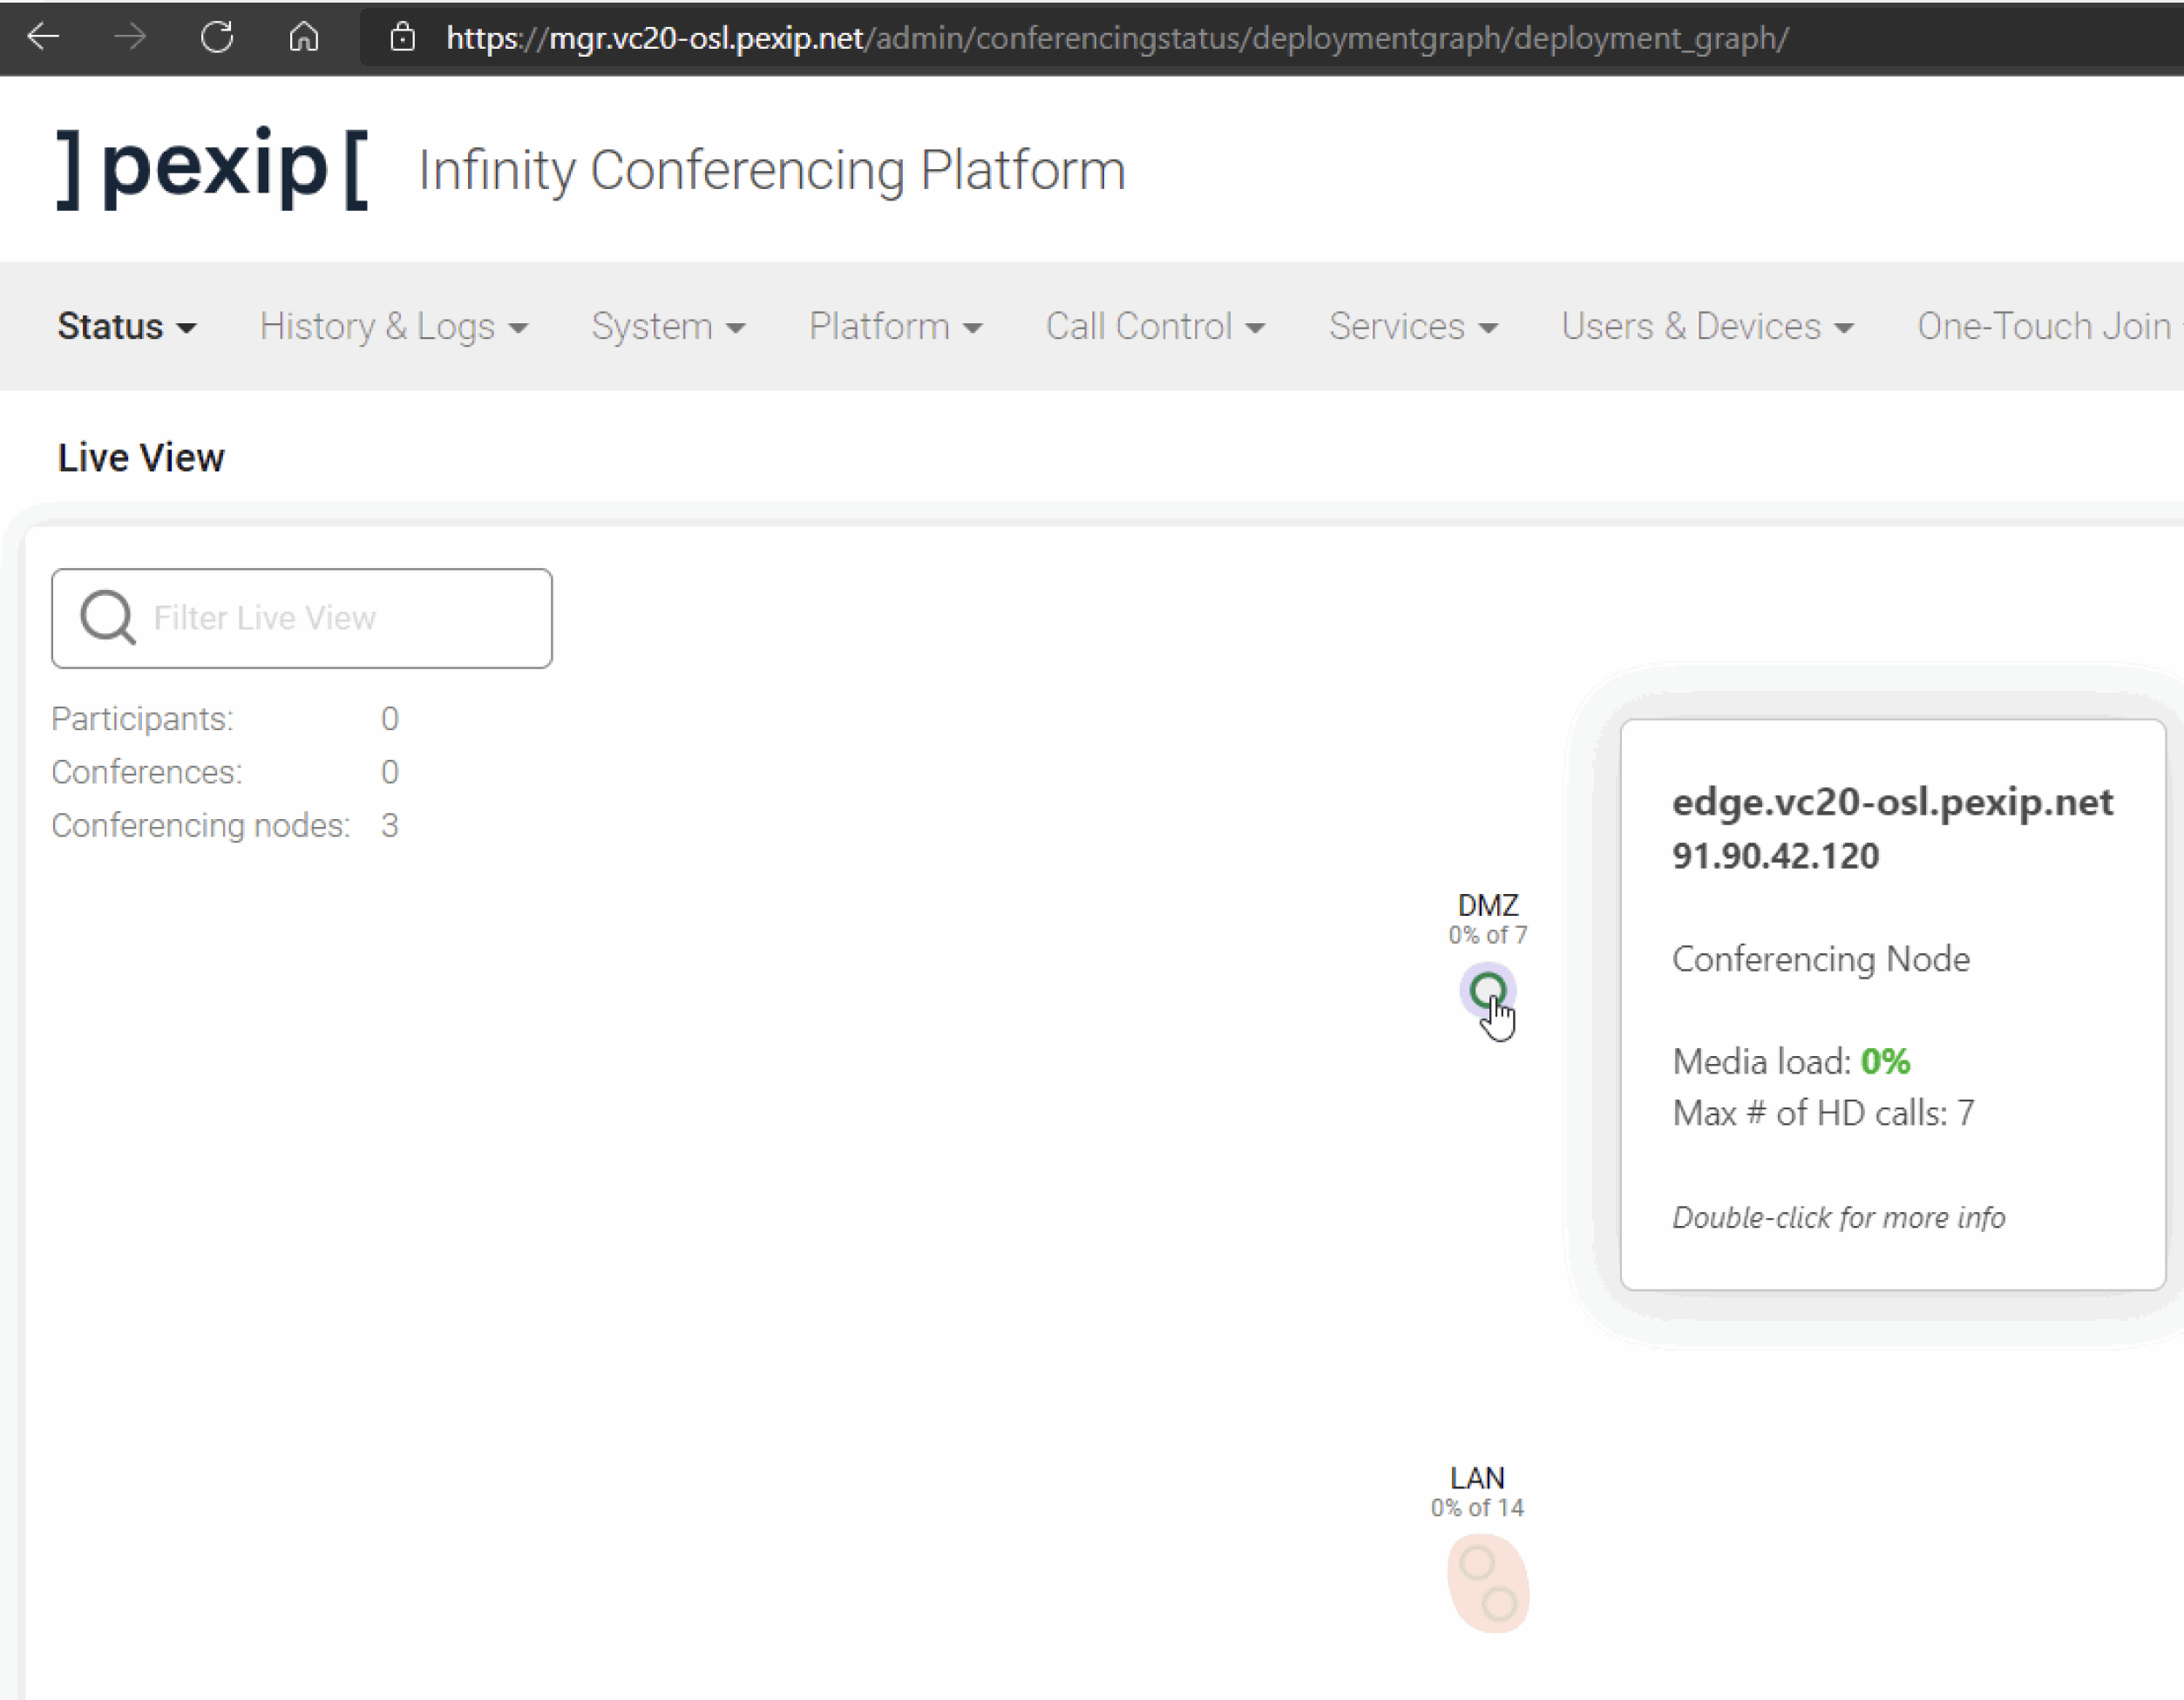
Section 2 4. Deploy External Conferencing Node ( just in the Transcoding Role).
Deploy External Conferencing Node (just in the Transcoding Role).
Demonstrate your working Pexip Infinity deployment.
Notes:
Use section #3 and section #4.1 of the lab sheet.
The Management Node is the first component you need to install in an Infinity deployment. It allows you to configure various Pexip Infinity services and integrations with other systems and provides a central point to view both ongoing and historical conferences. It also acts as a syslog server, providing a unified set of logs from all nodes in a deployment, including itself. It doesn’t take part in any conferencing duties, so no media or call signalling will pass through it. Currently, there is only one management node per Pexip Infinity deployment (although this may change in a later version). Every change you make on the management node takes up to 1 minute to replicate to other nodes in the deployment.
Pexip Infinity nodes run in a pure virtualised environment. You can think of a virtualised environment as having two main components:
• The host: this is the physical machine that is used to run the hypervisor.
• The guests: these are Virtual Machines (VMs) that run inside the hypervisor on the host.
In this lab we will use VMware ESXi as the hypervisor, but Pexip can run on many other hypervisors, both OnPrem and in the cloud (such as HyperV, Zen and KVM (all OnPrem), or Azure, GCP and AWS (in the cloud))

Slide 48
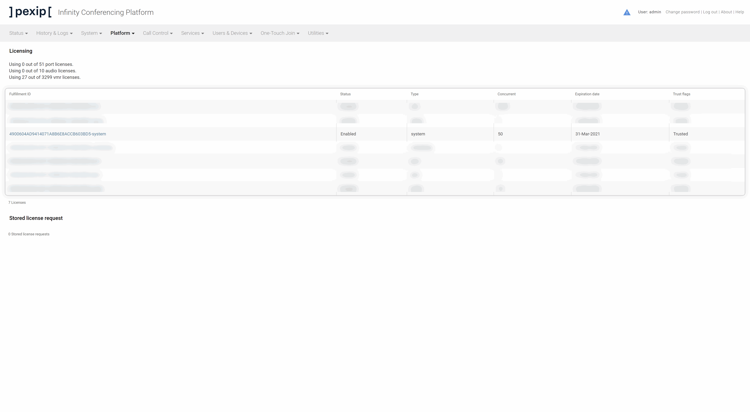
Section 2 5. Activate the Pexip Licenses.
Activate the Pexip Infinity Licence.
Demonstrate you have a fully licenced.

Slide 49
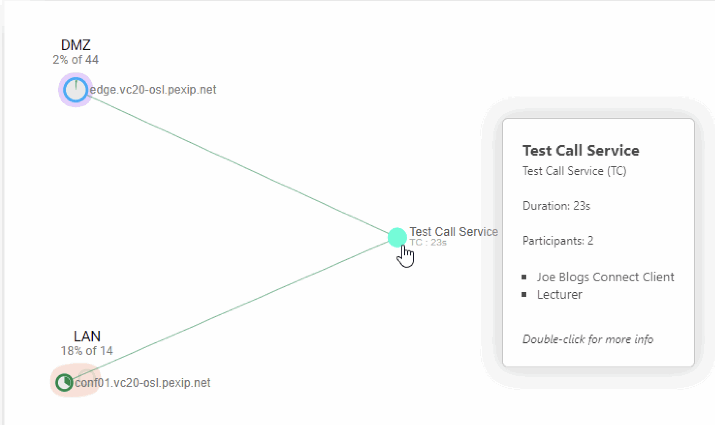
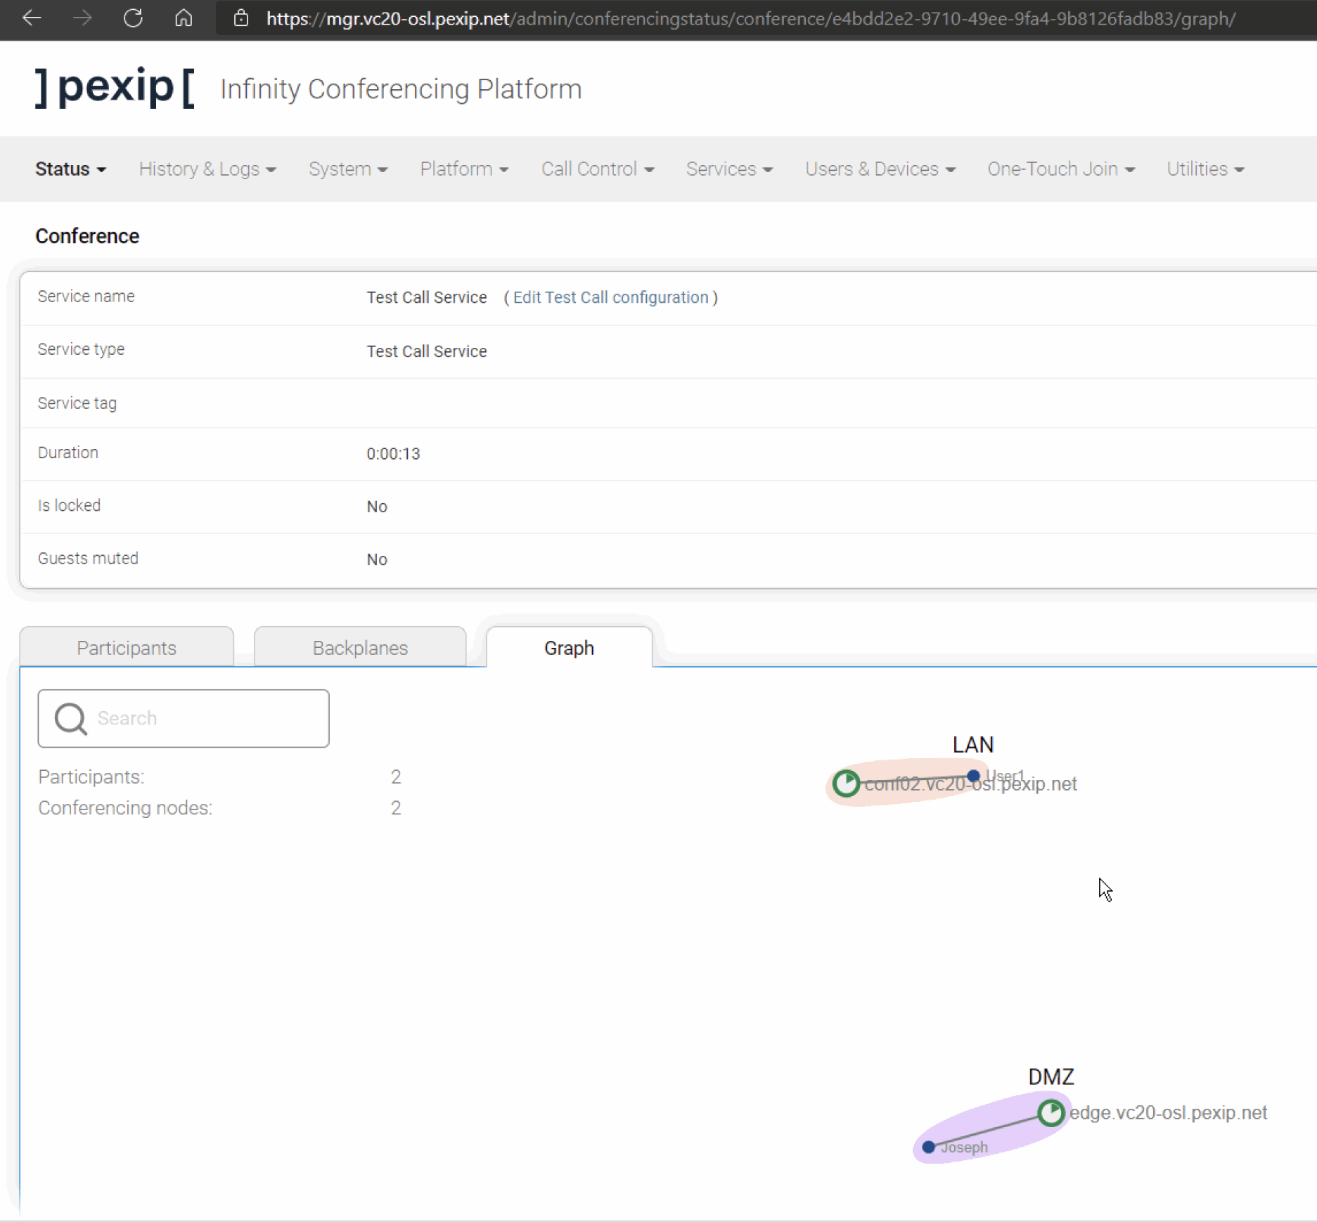
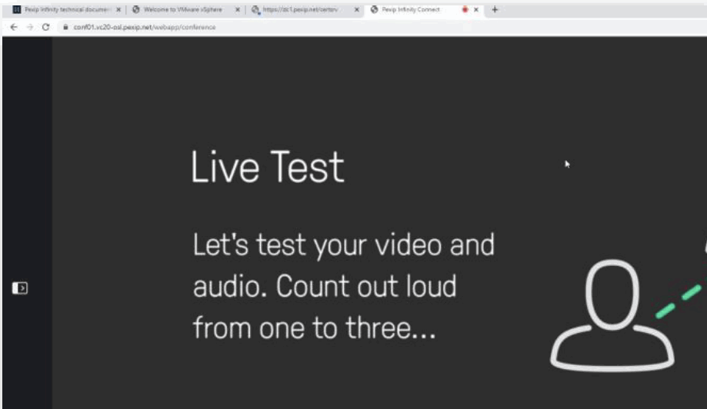
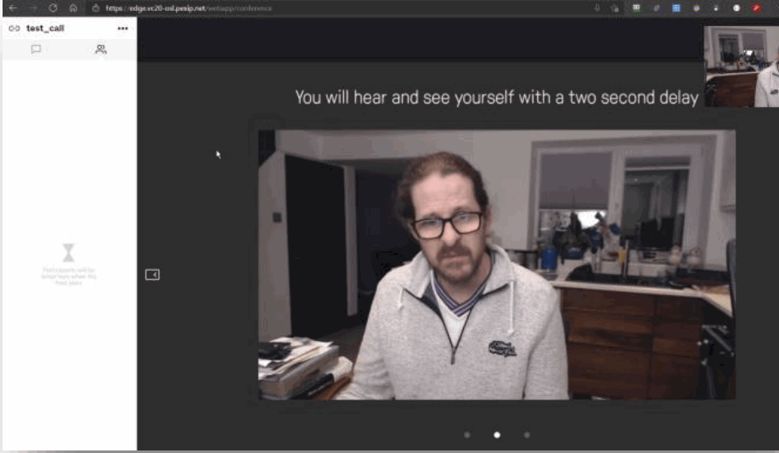
Section 2 6. Create a Test Call Service
Create a Test Call Service
Test and demonstrate your test calls.

Slide 50
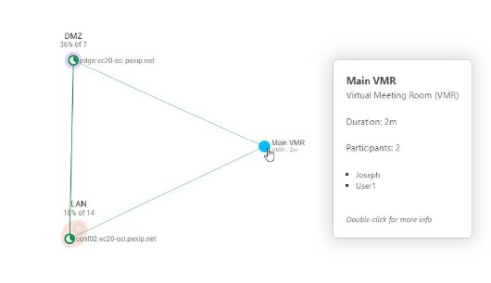
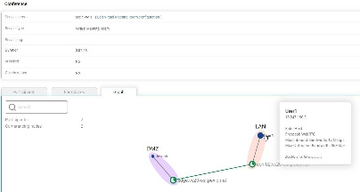
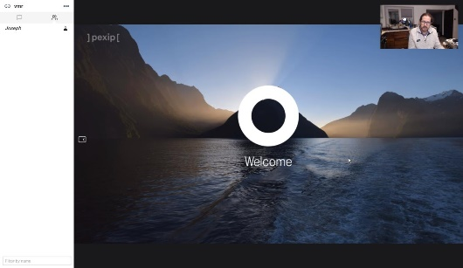
Section 2 7. Create a Virtual Meeting Room (with no PIN).
7.1 Create a VMR with no pin.
7.2 Test
7.3 Demonstrate your test calls.
7.4 Upload all your screenshots to the LMS using the template for Lab 1

Slide 51

Lunch-time!
Well done, you have successfully
Configure Pexip Management Nodes and Pexip Conferencing Nodes

Slide 52
Lab 2 Interop through to integration – 3.5 hours
Section 1 Switching from a Transcoding Edge Node to a Proxying Edge Node
Section 2 TLS Certificates
Section 3 Create a Virtual Auditorium
Section 4 Create a Virtual Meeting Room
Section 5 Create a Virtual Reception (Lobby / IVR)
Section 6 Infinity Connect Client Registration and Gateway P2P call

Slide 53
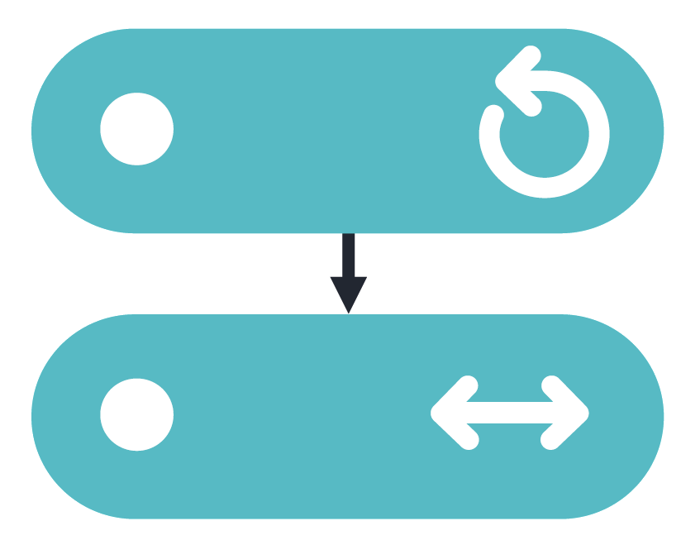


Section 1 1. Switching from a Transcoding Edge Node to a Proxying Edge Node
1.1 Switch from a Transcoding Edge Node to a Proxying Edge Node
1.2 Test
1.3 Demonstrate how to successfully configure Pexip Infinity Services

Slide 54




Section 2 2. TLS Certificates
2.1 Create TLS certificate for internal Transcoding Conferencing Nodes
2.1.1 Generate a CSR on Pexip Infinity
2.1.2 Creating the internal certificate
2.1.3 Complete the signing request and assign the certificate in the Pexip Infinity deployment
2.2 Upload the internal CA root certificate
2.3 Create a TLS certificate for external Proxying Edge Node
2.3.1 Using a third-party Certificate Authority via a self- generated PEM certificate bundle
2.4Removing ALL temporary certificates
2.5 Test
2.6 Demonstrate how to successfully configure Pexip Infinity Services

Slide 55





Section 3 3. Create a Virtual Auditorium
Challenge
3.1 Create a Virtual Auditorium for hosts and guests, ensure that you have set a Host PIN and “Allow guests” is set to “Yes”.
3.2 Test
Pexip EndPoints PexEPs.
Internal (LAN):
http://10.247.180.6/gui/ - SD
http://10.247.180.7/gui/ - HD
External (DMZ):
US: http://us-pexep.pex.me
Europe: http://no-pexep.pex.me
Australia: http://au-pexep.pex.me
3.3 Demonstrate how to successfully configure Pexip Infinity Services

Slide 56

Section 4 4. Create a series of Virtual Meeting Room
4.1 Create a secure VMR to allow some users to manage the conference
4.2 Create a semi-secure VMR allowing easy access for guests
4.3 Create a secure VMR only for C level users
4.4 Create a VMR to show two main speakers but do not allow presentation
4.5 Create a VMR to show participant names and limit the room capacity to 3
4.6 Test (PexEPs)
4.7 Demonstrate how to successfully configure Pexip Infinity Services

Slide 57


Section 5 5. Create a Virtual Reception (Lobby / IVR)
5 Create a ‘General VR’ with a second alias as a numeric
5.2 Test
5.3 Demonstrate how to successfully configure Pexip Infinity Services
See Administrator Logs

Slide 58








Section 6 6. Infinity Connect Client Registration and Gateway P2P call
6.1 To register a device, configure Infinity to accept the registration
6.2 Configure the Connect client to register to Infinity
6.3 Add Routing Rules
6.4 Test
6.5 Grab some screenshots of the registered devices and status in Infinity
6.7 Upload all saved screenshots from today’s session to the LMS in the template provided.

Slide 59




Section 7 7.Enable LDAP management login authentication
1.1 Configure LDAP Authentication
1.2 Test
2.3 Demonstrate your ability to administer a Pexip Infinity system

Slide 60
Home-time!
Well done, end of day 1 and you have successfully
Configure Pexip Management Nodes and Pexip Conferencing Nodes
Demonstrate product use and administrator tasks

Slide 61
Day 2
Agenda:
Recap
Tasks for today
Next Steps

Slide 62

Lab 3 Media traversal and more integrations – 2.5 hours
Section 1 Google Meet Integration
Section 2 Microsoft Teams Integration
Section 3 IVR and Audio / PSTN Connectivity
(Extra Credit)
Section 4 Skype for Business Integration

Slide 63







Section 1 1. Google Meet Integration
1.1 log into the Google Admin portal (https://admin.google.com/),
1.1.1Navigate to YOUR GROUP’S OU.
i.e VC01
1.1.2 Interoperability: You need to enable interoperability for your group (or Organisational Unit)
1.1.3 Configure 2 Gateways for interoperability:
trusted & untrusted devices are required
Generate Token for Infinity
1.1.4 Configure the Google Meet settings using the RDP session
1.2 Login to GUI
1.2.1 Add 2 Google Licences for each token
1.2.2 Add 2 different call routing rules
1.3 Test
1.4 Demonstrate how to configure the Pexip Infinity system with a 3rd party integrations.

Slide 64






Section 2 2. Microsoft Teams Integration
2.1 Configure your Pexip Infinity deployment with the integration details of the Teams connector
2.2 Setup Pexip to act as a gateway to Teams
2.2.1 VR
2.2.2 Routing Rules
2.3 Test

Slide 65

Section 3 IVR and Audio / PSTN Connectivity
Challenge
3. Demonstrate how to configure IVR and Audio / PSTN Connectivity
3.1 Test
3.2 Demonstrate how to configure the Pexip Infinity system with a 3rd party integrations
3.3 Upload all your screenshots to the LMS using the template provided for Lab 3.
(Extra Credit)
Section 4 Skype for Business Integration

Slide 66
Lunch-time!
Well done, you have now successfully
Configure Pexip Management Nodes and Pexip Conferencing Nodes
Demonstrate product use and administrator tasks
Identify integration capabilities in Pexip solutions

Slide 67
Lab 4 Join and user experience - 2.5 hours
Section 1 Configure and Activate Pexip Smart Scale
Section 2 Upgrading Pexip
Section 3 Customizing the user experience (UX)
(Extra Credits)
Section 4 LDAP VMR Sync/Import
Section 5 NUMA Pinning
Section 6 Upgrade and test a beta version

Slide 68


Section 1 1 Configure and Activate Pexip Smart Scale
1.1 Enable PSS
1.2 Create a System Location to contain the PSS nodes
1.3 Configure PSS location
1.4 Configure the DMZ System location
1.5 Configure the LAN System location
1.6 Test
1.7 Demonstrate your ability to administer a Pexip Infinity system

Slide 69





Section 2 1. Upgrading Pexip
1.1 Upgrading Pexip
1.2 Test
1.3 Demonstrate Pexip has been upgraded
1.4 Remove snapshots

Slide 70





Section 3 1. Customizing the user experience (UX)
1.1 Build asset files in NextGen Portal
1.2 Demonstrate your ability to customise Infinity by showing a customised WebApp landing page, including a subtle corporate logo.
1.2.1 Test
1.3 Demonstrate your ability to customise Infinity by showing a customised in-conference experience, including a subtle corporate logo. (Welcome screen)
1.3.1 Test
1.4 Upload all the screenshots to the LMS using the template for Lab 4
Peer review & Self Assessment.
(Extra Credits)
Section 4 LDAP VMR Sync/Import
Section 5 NUMA Pinning
Section 6 Upgrade and test a beta version

Slide 71

Wow! You done it!
Let’s Reflect -
What?
How?
Why?

Slide 72
How to raise a ticket.

Slide 73




Troubleshooting Triage.
Establish
Investigate
Report
Issue & Scale
Diagnostics & Troubleshooting Priority & Fault Evidence
3 Point methodology applied when raising a ticket
Notes:
To guide you through the fault-finding process, Pexip has developed it’s best practice troubleshooting triage to work within when looking to raise a support request in the Help centre, or via email to support@pexip.com.

Slide 74


Establish
Investigate
Report
Action 1
Key Facts
Ascertain issue & scale
Action 2 Fault Find
Step 1 Management Node
Action 3 Evidence
Step 1 Alarms
Action 4
Create Request
Step 2 Client’s IT
Step 3 Client’s Architecture
Step 2 Live View
Step 3 Conference History
Step 4 Participant History
Step 1 Open a ticket
Step 3 Complete Form
Step 4 Attachments
Step 5 Check & Submit
Step 6 Pexip Tech Support
Step 2 Set SLA priority Level
Step 6 Snapshot & Packet Capture
Step 5 Test Calling
Step 5a Email
3 Point methodology applied when raising a ticket
Pexip Self-Hosted
Issue & Scale
Diagnostics & Troubleshooting Priority & Fault Evidence
Notes:
This includes a number of resources to help investigate an Infinity issue.

Slide 75


Tools for Partners
Online Documentation (docs.pexip.com)
Online Documentation (docs.pexip.com)
Pexip Infinity GUI
Pexip Log Tools
Partner Portal
Test Call Service (https://docs.pexip.com/admin/test_call_service.htm)
Pexip Log tools
Notes:
every Partner has a support toolkit to tap into at his / her fingertips.

Slide 76

In-built help within the Pexip Infinity Conferencing Platform
Notes:
every Partner has a support toolkit to tap into at his / her fingertips.

Slide 77

In-built contextual help within the Pexip Infinity Conferencing Platform GUI
Notes:
every Partner has a support toolkit to tap into at his / her fingertips.

Slide 78





Diagnostic tools
Notes:
every Partner has a support toolkit to tap into at his / her fingertips.

Slide 79

Partner Portal
Notes:
every Partner has a support toolkit to tap into at his / her fingertips.

Slide 80
Takeaways

Slide 81

Docs.Pexip.com
https://docs.pexip.com/admin/download_pdf.htm#admin

Slide 82
Home-time!
Well done, you have now successfully completed all course objectives
Configure Pexip Management Nodes and Pexip Conferencing Nodes
Demonstrate product use and administrator tasks
Identify integration capabilities in Pexip solutions
Identify the communication technologies supported by Pexip Infinity
Knowledge Empowers

Slide 83





Next Steps
CTE Diagnostics – July 2022
Live Virtual Clinics (optional) – 4 hours
Final Assessment – LMS

